Slide 1
Introduction
to
Suffix link
aka
Failure link

Slide 2
Pattern Strings
a | t
a | r | t
o | a | r | s
s | o | a | r

Slide 3
Pattern Strings
t
a | t
a | r | t
o | a | r | s
s | o | a | r
a
r
t
o
a
r
s
s
o
a
r

Slide 4
Pattern Strings
t
a | t
a | r | t
o | a | r | s
s | o | a | r
a
r
t
o
a
r
s
s
o
a
r
s | o | a | r | s

Slide 5
Pattern Strings
t
a | t
a | r | t
o | a | r | s
s | o | a | r
a
r
t
o
a
r
s
s
o
a
r
s | o | a | r | s

Slide 6
Pattern Strings
t
a | t
a | r | t
o | a | r | s
s | o | a | r
a
r
t
o
a
r
s
s
o
a
r
s | o | a | r | s

Slide 7
Pattern Strings
t
a | t
a | r | t
o | a | r | s
s | o | a | r
a
r
t
o
a
r
s
s
o
a
r
s | o | a | r | s

Slide 8
Pattern Strings
t
a | t
a | r | t
o | a | r | s
s | o | a | r
a
r
t
o
a
r
s
s
o
a
r
s | o | a | r | s

Slide 9
Pattern Strings
t
a | t
a | r | t
o | a | r | s
s | o | a | r
a
r
t
o
a
r
s
s
o
a
r
s | o | a | r | s

Slide 10
Pattern Strings
t
a | t
a | r | t
o | a | r | s
s | o | a | r
a
r
t
o
a
r
s
s
o
a
r
s | o | a | r | s

Slide 11
Pattern Strings
t
a | t
a | r | t
o | a | r | s
s | o | a | r
a
r
t
o
a
r
s
s
o
a
r
s | o | a | r | s

Slide 12
Pattern Strings
t
a | t
a | r | t
o | a | r | s
s | o | a | r
a
r
t
o
a
r
s
s
o
a
r
s | o | a | r | s

Slide 13
Pattern Strings
t
a | t
a | r | t
o | a | r | s
s | o | a | r
a
r
t
o
a
r
s
s
o
a
r
s | o | a | r | s

Slide 14
Pattern Strings
t
a | t
a | r | t
o | a | r | s
s | o | a | r
a
r
t
o
a
r
s
s
o
a
r
s | o | a | r | s

Slide 15
Pattern Strings
t
a | t
a | r | t
o | a | r | s
s | o | a | r
a
r
t
o
a
r
s
s
o
a
r
s | o | a | r | s

Slide 16
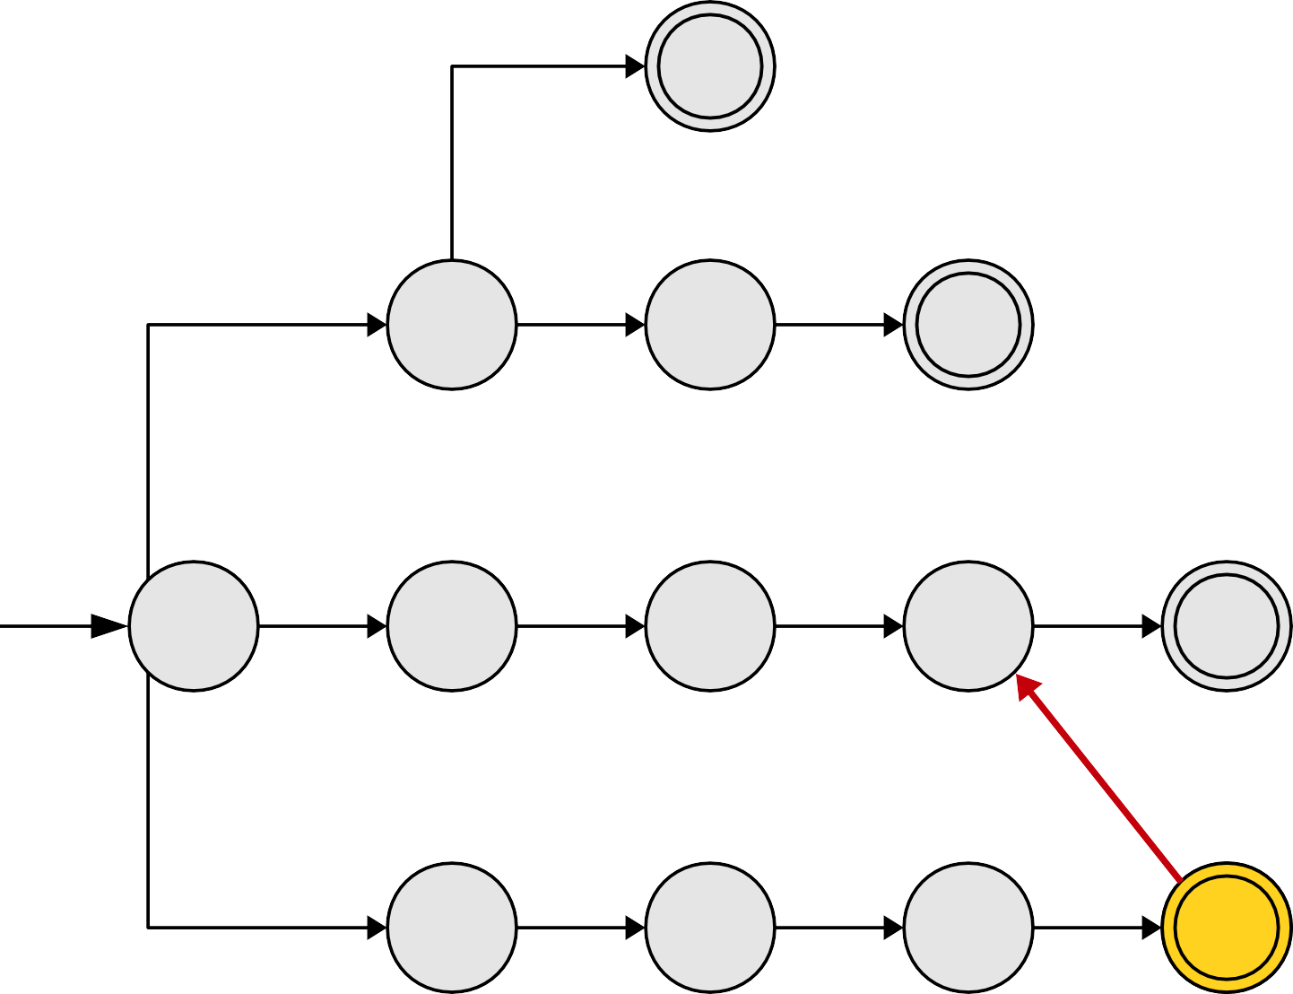
Pattern Strings
t
a | t
a | r | t
o | a | r | s
s | o | a | r
a
r
t
o
a
r
s
s
o
a
r
s | o | a | r | s

Slide 17
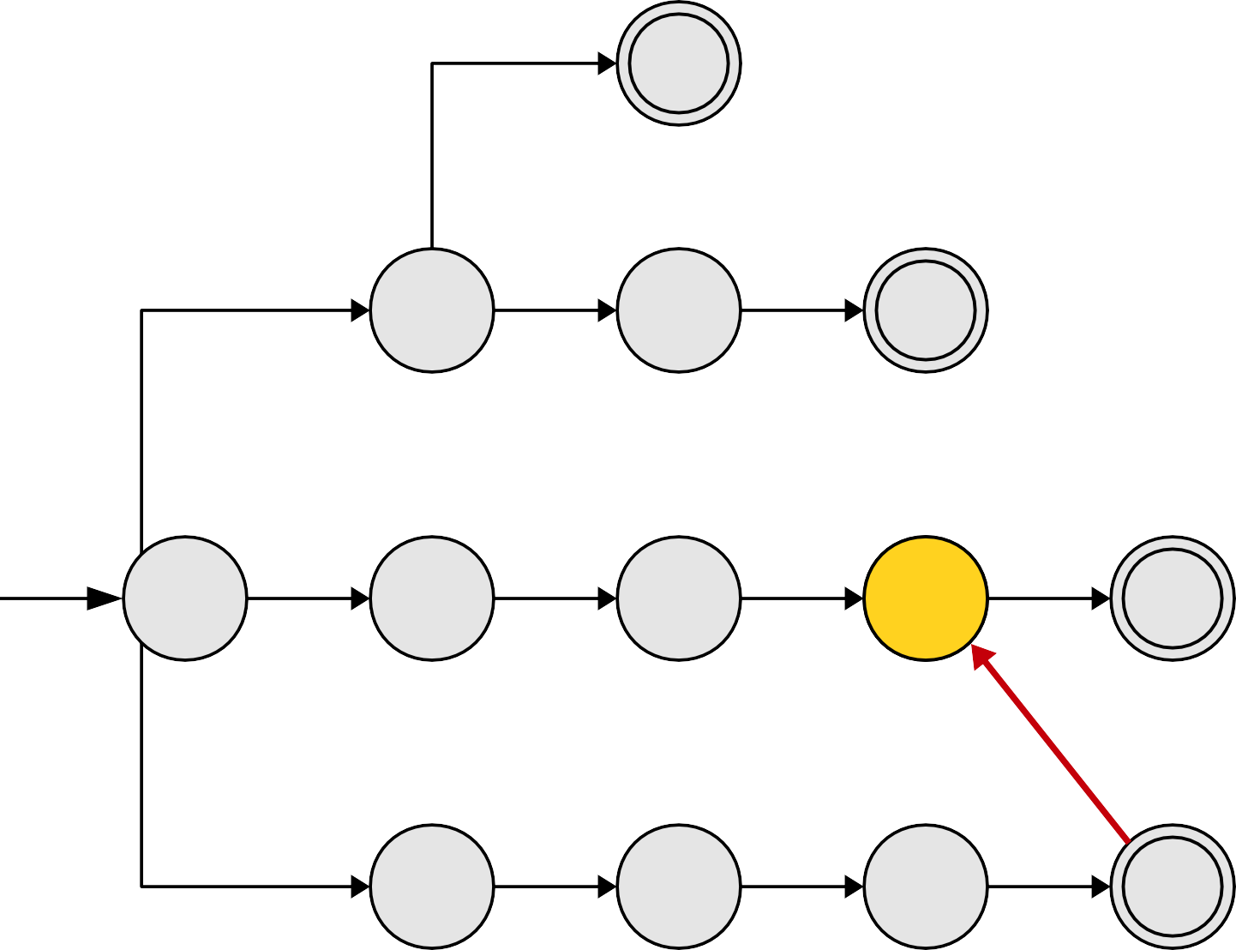
Pattern Strings
t
a | t
a | r | t
o | a | r | s
s | o | a | r
a
r
t
o
a
r
s
s
o
a
r
s | o | a | r | s

Slide 18
Pattern Strings
t
a | t
a | r | t
o | a | r | s
s | o | a | r
a
r
t
o
a
r
s
s
o
a
r
s | o | a | r | s

Slide 19
Pattern Strings
t
a | t
a | r | t
o | a | r | s
s | o | a | r
a
r
t
o
a
r
s
s
o
a
r
s | o | a | r | s

Slide 20
Pattern Strings
t
a | t
a | r | t
o | a | r | s
s | o | a | r
a
r
t
o
a
r
s
s
o
a
r
This red link is called a suffix link. We'll talk about them more formally in a minute.
s | o | a | r | s

Slide 21
Pattern Strings
t
a | t
a | r | t
o | a | r | s
s | o | a | r
a
r
t
o
a
r
s
s
o
a
r
o | a | r | t

Slide 22
Pattern Strings
t
a | t
a | r | t
o | a | r | s
s | o | a | r
a
r
t
o
a
r
s
s
o
a
r
o | a | r | t

Slide 23
Pattern Strings
t
a | t
a | r | t
o | a | r | s
s | o | a | r
a
r
t
o
a
r
s
s
o
a
r
o | a | r | t

Slide 24
Pattern Strings
t
a | t
a | r | t
o | a | r | s
s | o | a | r
a
r
t
o
a
r
s
s
o
a
r
o | a | r | t

Slide 25
Pattern Strings
t
a | t
a | r | t
o | a | r | s
s | o | a | r
a
r
t
o
a
r
s
s
o
a
r
o | a | r | t

Slide 26
Pattern Strings
t
a | t
a | r | t
o | a | r | s
s | o | a | r
a
r
t
o
a
r
s
s
o
a
r
o | a | r | t

Slide 27
Pattern Strings
t
a | t
a | r | t
o | a | r | s
s | o | a | r
a
r
t
o
a
r
s
s
o
a
r
o | a | r | t

Slide 28
Pattern Strings
t
a | t
a | r | t
o | a | r | s
s | o | a | r
a
r
t
o
a
r
s
s
o
a
r
o | a | r | t

Slide 29
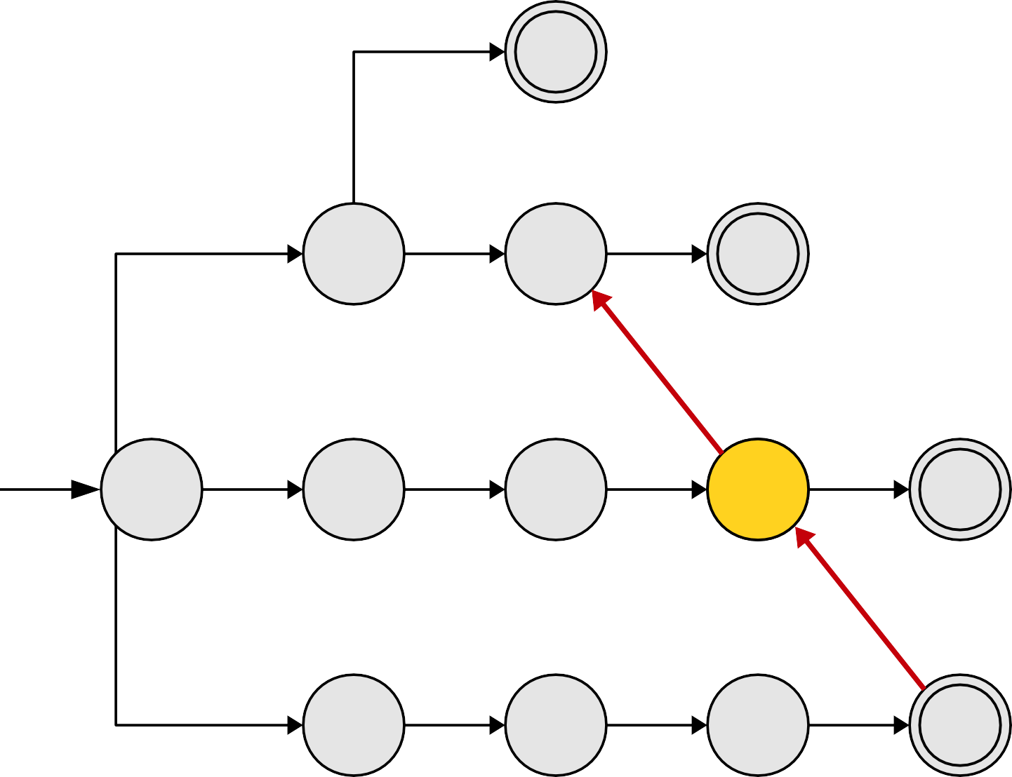
Pattern Strings
t
a | t
a | r | t
o | a | r | s
s | o | a | r
a
r
t
o
a
r
s
s
o
a
r
o | a | r | t

Slide 30
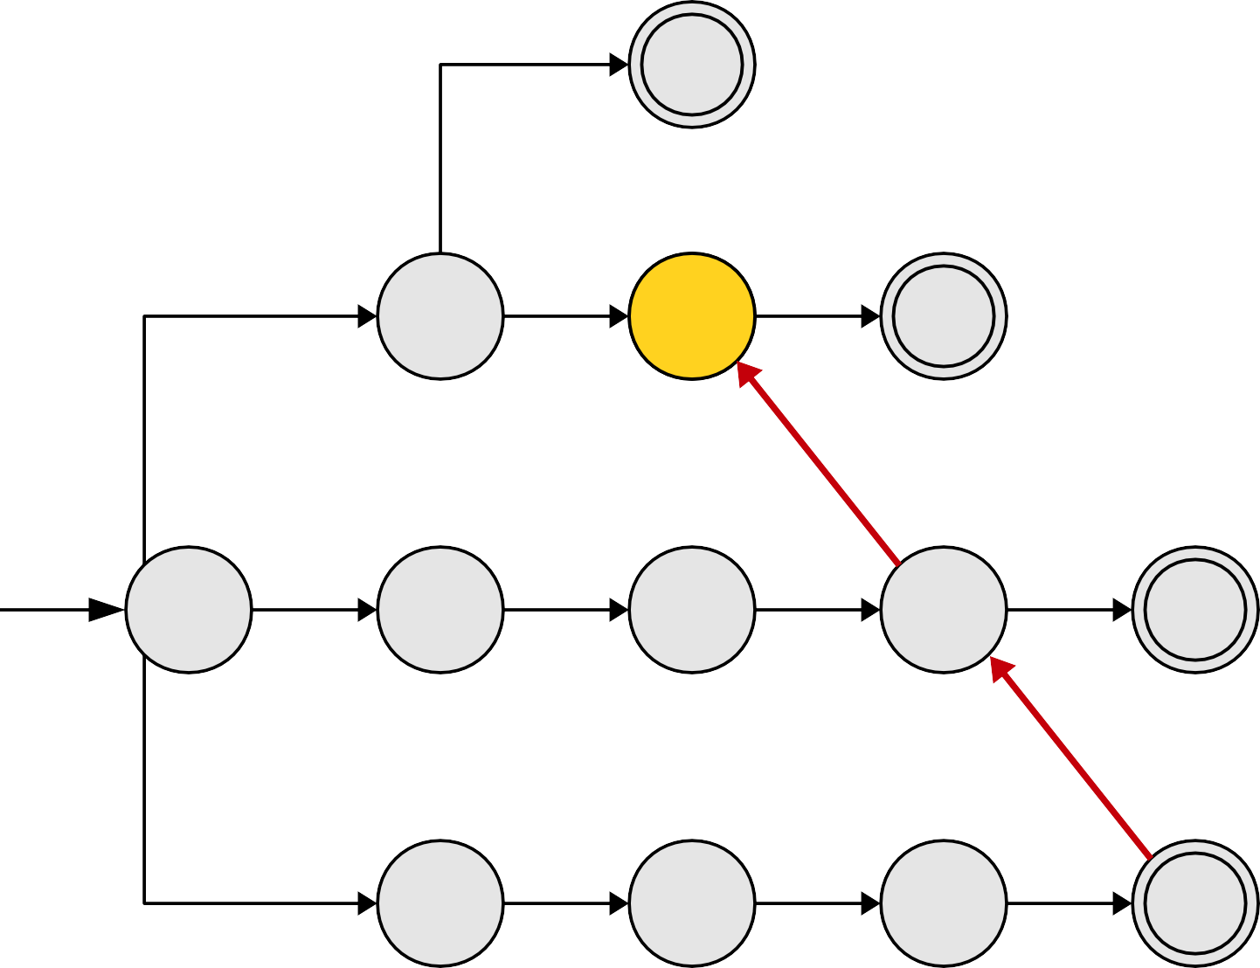
Pattern Strings
t
a | t
a | r | t
o | a | r | s
s | o | a | r
a
r
t
o
a
r
s
s
o
a
r
o | a | r | t

Slide 31
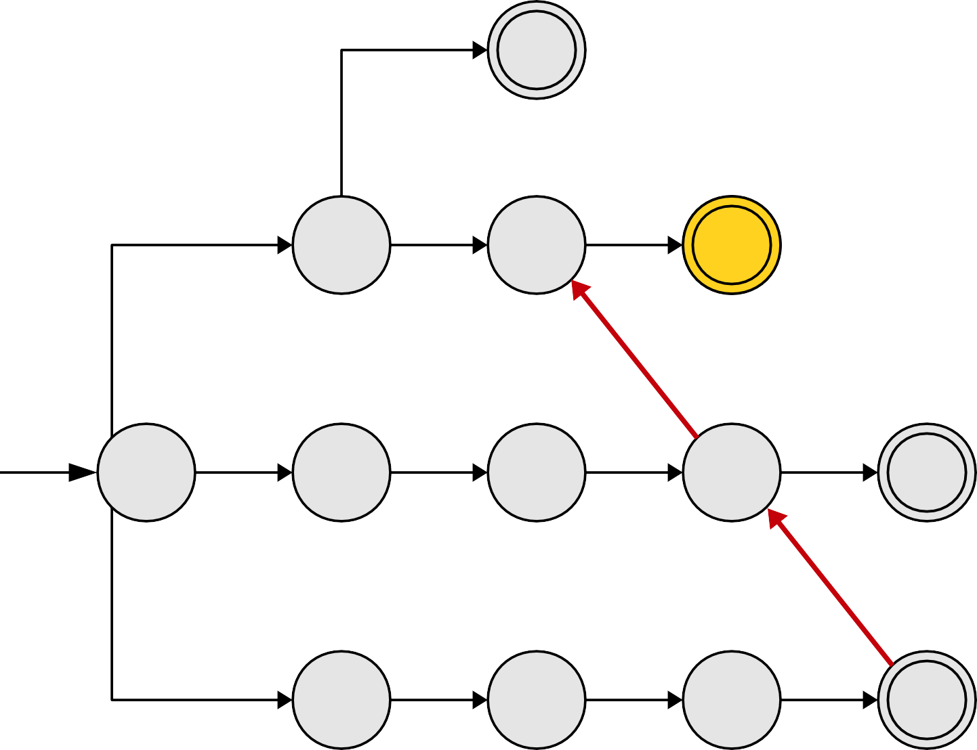
Pattern Strings
t
a | t
a | r | t
o | a | r | s
s | o | a | r
a
r
t
o
a
r
s
s
o
a
r
o | a | r | t

Slide 32
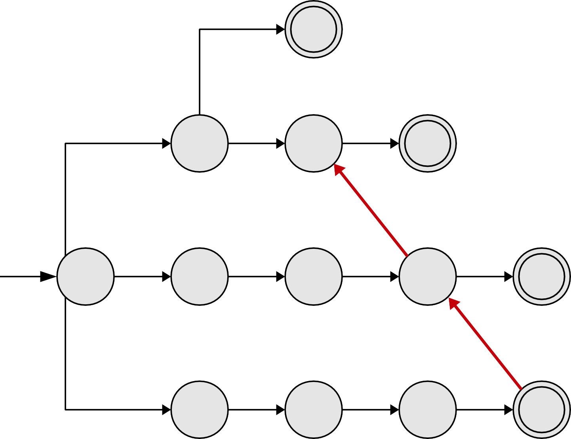
Pattern Strings
t
a | t
a | r | t
o | a | r | s
s | o | a | r
a
r
t
o
a
r
s
s
o
a
r

Slide 33
Pattern Strings
t
a | t
a | r | t
o | a | r | s
s | o | a | r
a
r
t
o
a
r
s
s
o
a
r
s | o | a | t

Slide 34
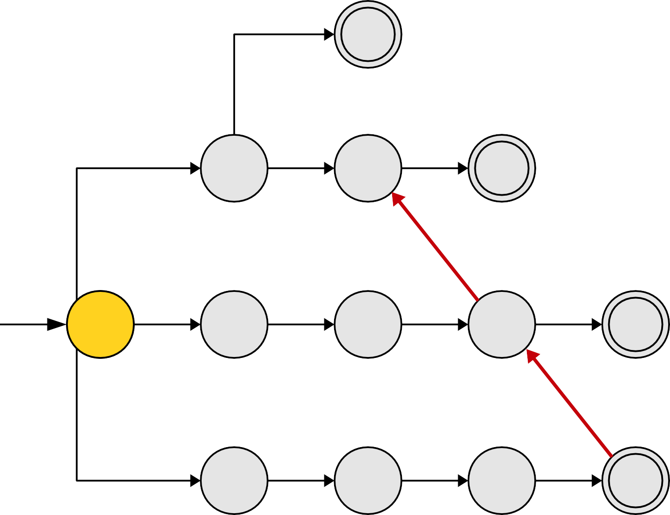
Pattern Strings
t
a | t
a | r | t
o | a | r | s
s | o | a | r
a
r
t
o
a
r
s
s
o
a
r
s | o | a | t

Slide 35
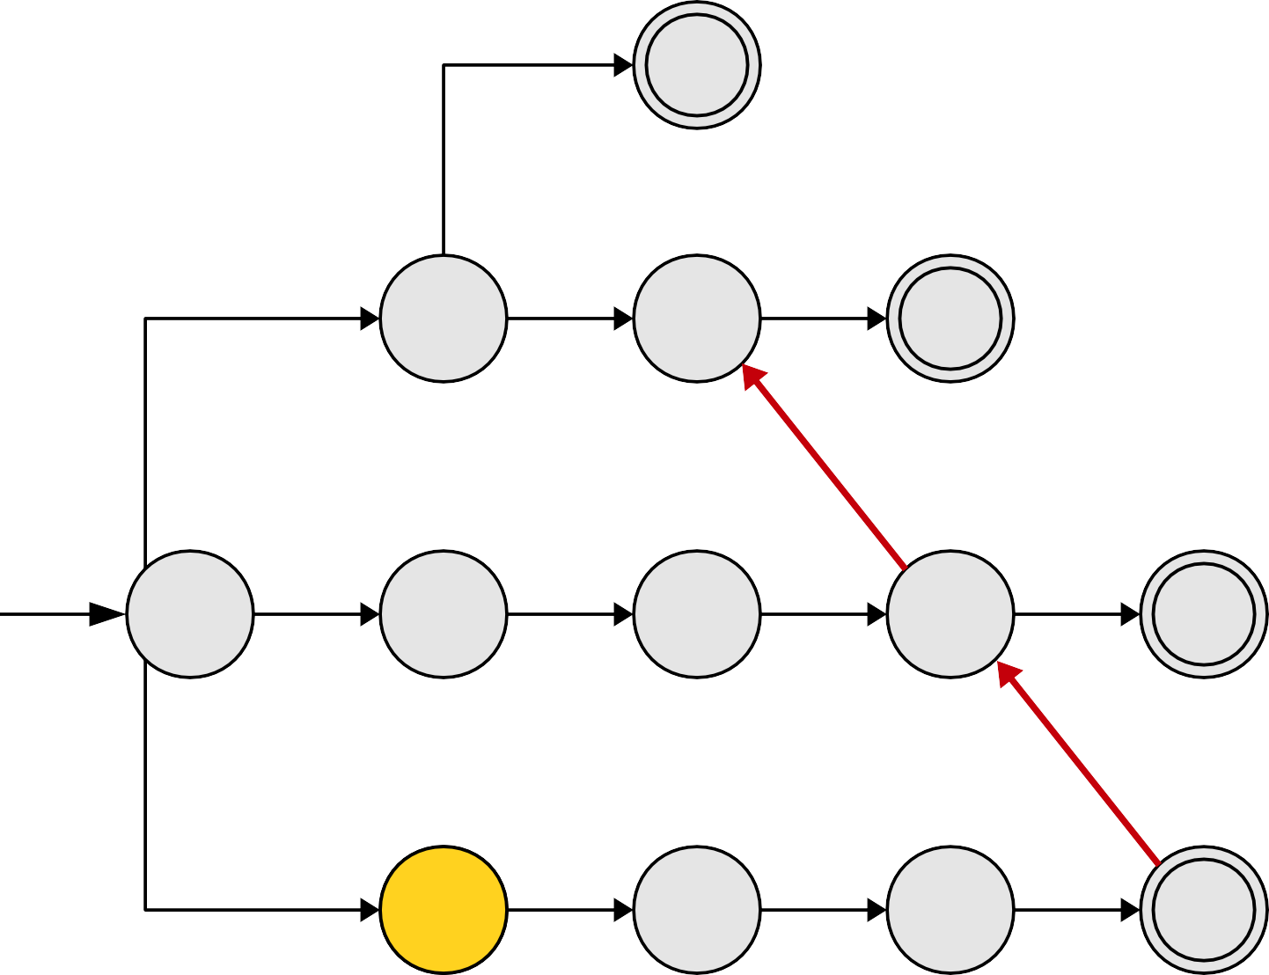
Pattern Strings
t
a | t
a | r | t
o | a | r | s
s | o | a | r
a
r
t
o
a
r
s
s
o
a
r
s | o | a | t

Slide 36
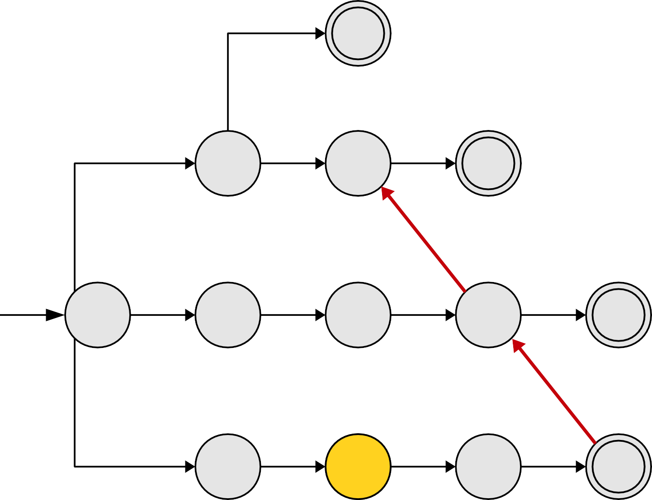
Pattern Strings
t
a | t
a | r | t
o | a | r | s
s | o | a | r
a
r
t
o
a
r
s
s
o
a
r
s | o | a | t

Slide 37
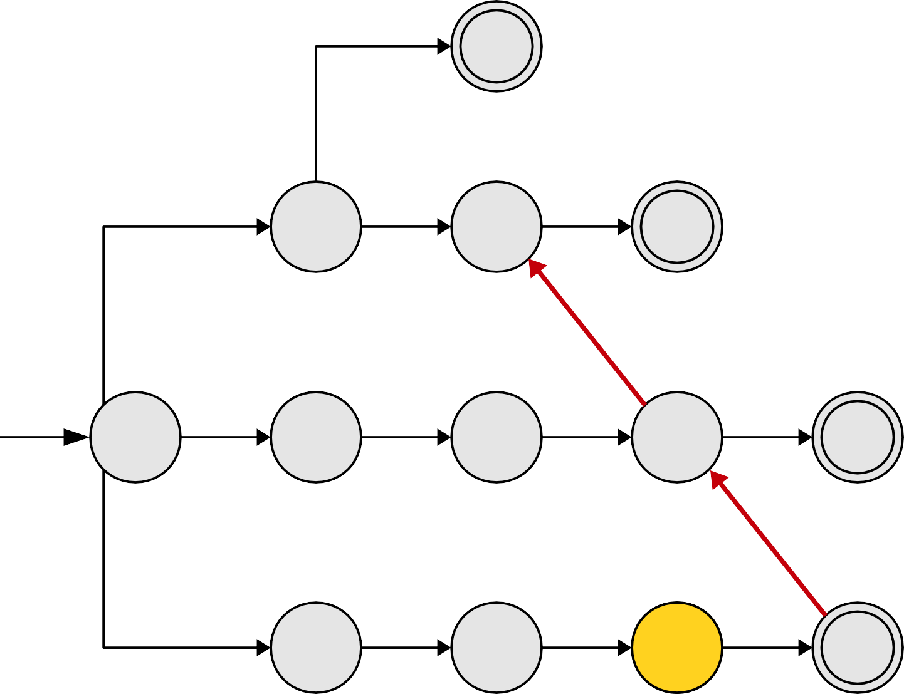
Pattern Strings
t
a | t
a | r | t
o | a | r | s
s | o | a | r
a
r
t
o
a
r
s
s
o
a
r
s | o | a | t

Slide 38
Pattern Strings
t
a | t
a | r | t
o | a | r | s
s | o | a | r
a
r
t
o
a
r
s
s
o
a
r
s | o | a | t

Slide 39
Pattern Strings
t
a | t
a | r | t
o | a | r | s
s | o | a | r
a
r
t
o
a
r
s
s
o
a
r
s | o | a | t

Slide 40
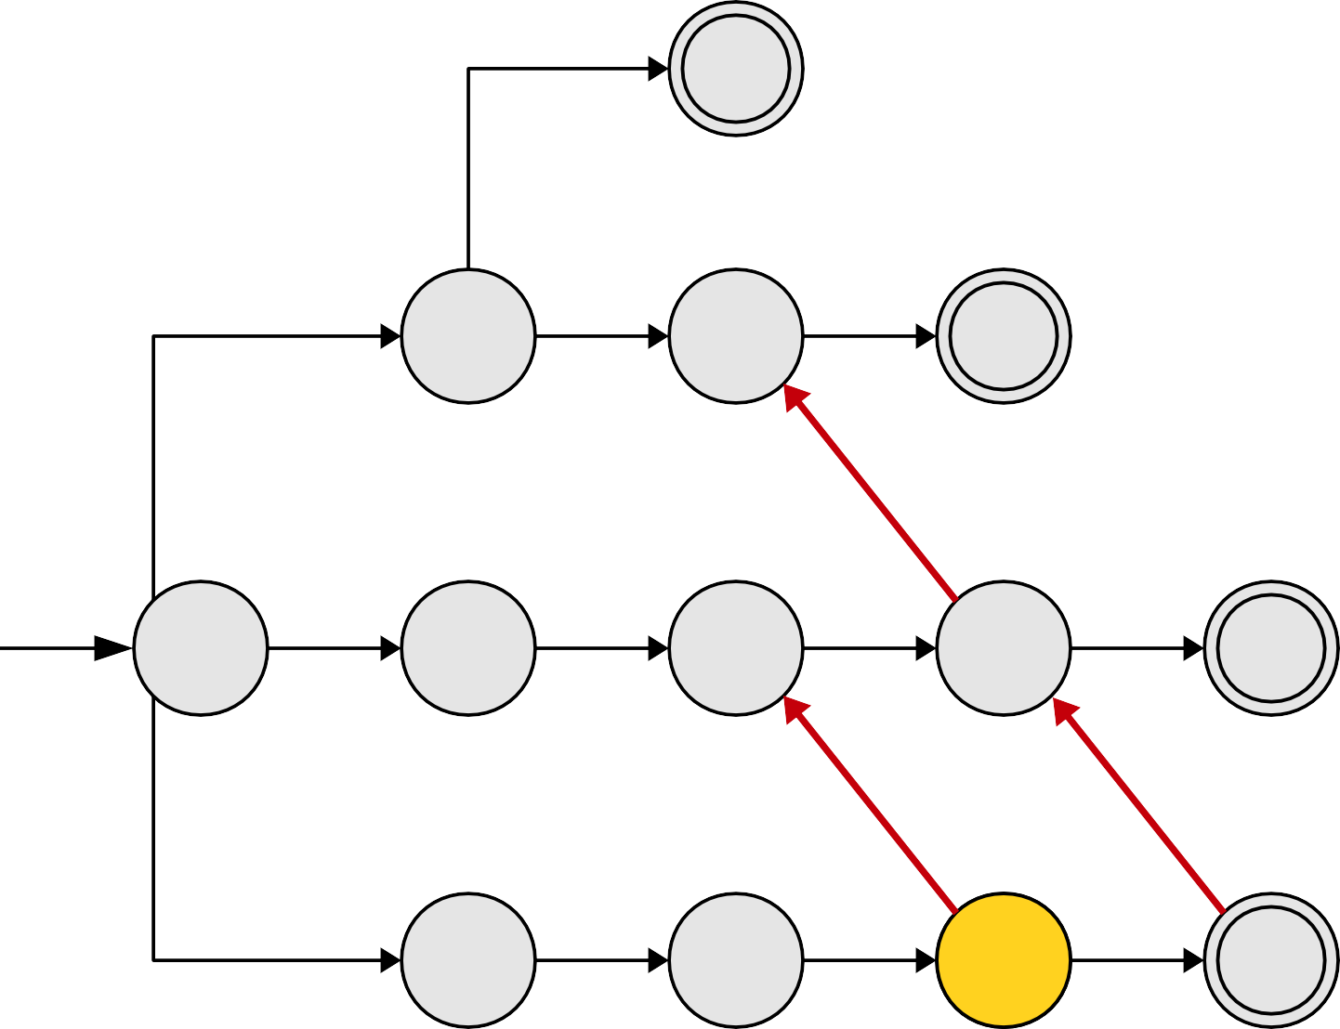
Pattern Strings
t
a | t
a | r | t
o | a | r | s
s | o | a | r
a
r
t
o
a
r
s
s
o
a
r
s | o | a | t

Slide 41
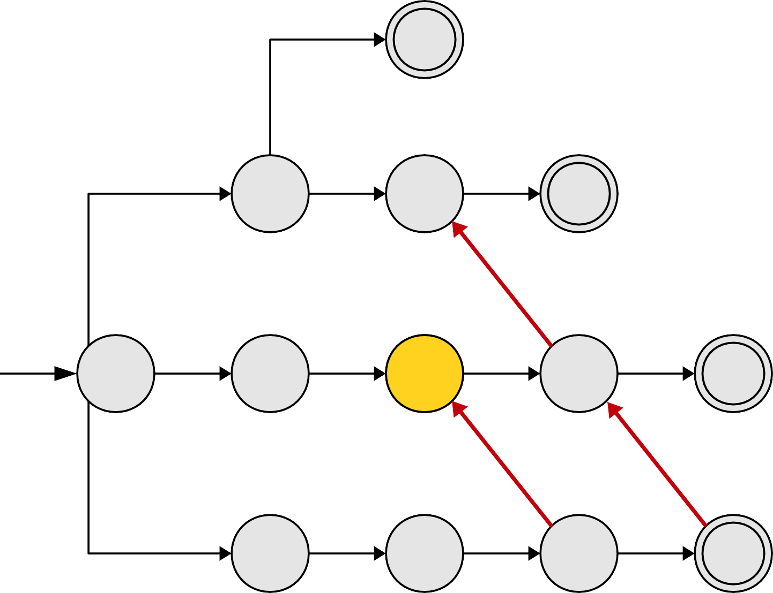
Pattern Strings
t
a | t
a | r | t
o | a | r | s
s | o | a | r
a
r
t
o
a
r
s
s
o
a
r
s | o | a | t

Slide 42
Pattern Strings
t
a | t
a | r | t
o | a | r | s
s | o | a | r
a
r
t
o
a
r
s
s
o
a
r
s | o | a | t

Slide 43
Pattern Strings
t
a | t
a | r | t
o | a | r | s
s | o | a | r
a
r
t
o
a
r
s
s
o
a
r
s | o | a | t

Slide 44
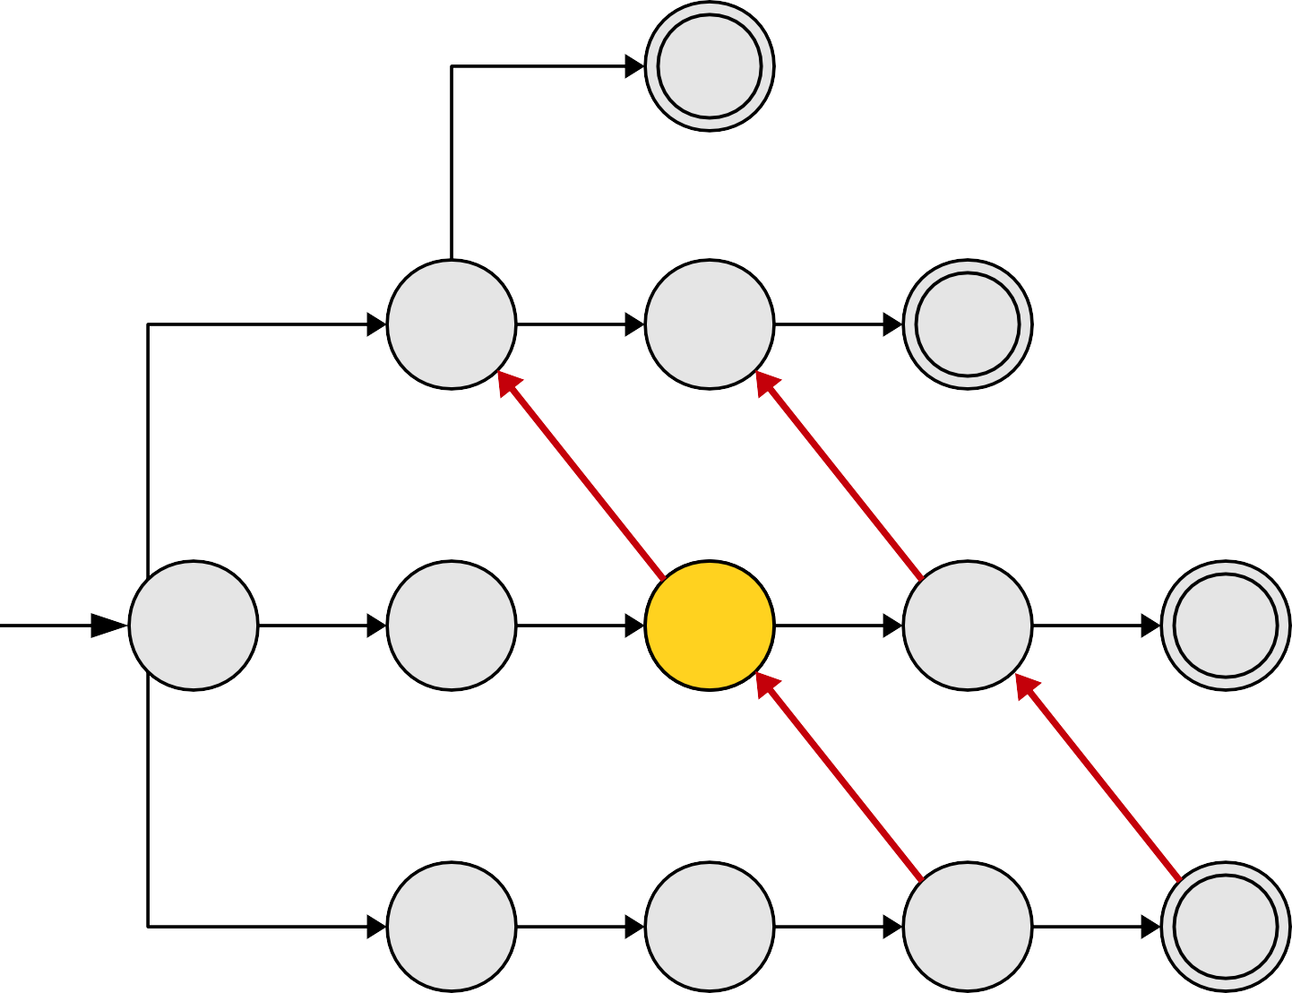
Pattern Strings
t
a | t
a | r | t
o | a | r | s
s | o | a | r
a
r
t
o
a
r
s
s
o
a
r
s | o | a | t

Slide 45
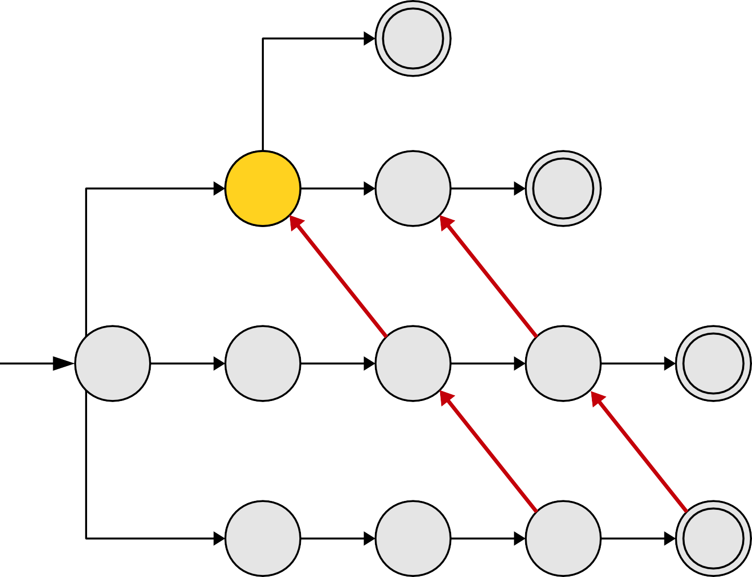
Pattern Strings
t
a | t
a | r | t
o | a | r | s
s | o | a | r
a
r
t
o
a
r
s
s
o
a
r
s | o | a | t

Slide 46
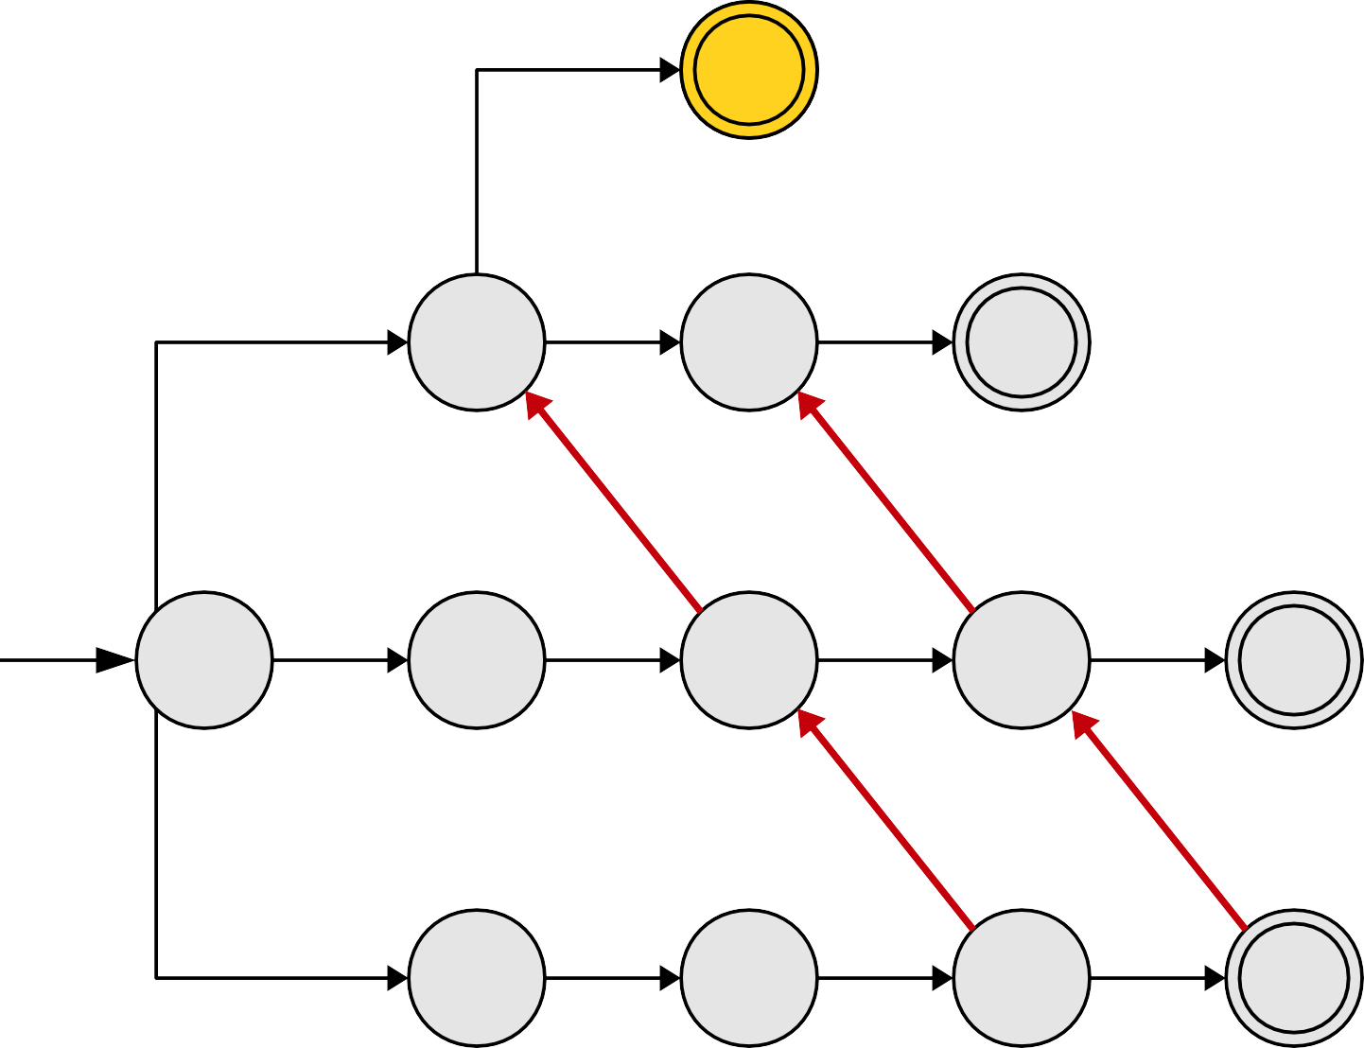
Pattern Strings
t
a | t
a | r | t
o | a | r | s
s | o | a | r
a
r
t
o
a
r
s
s
o
a
r
s | o | a | t

Slide 47
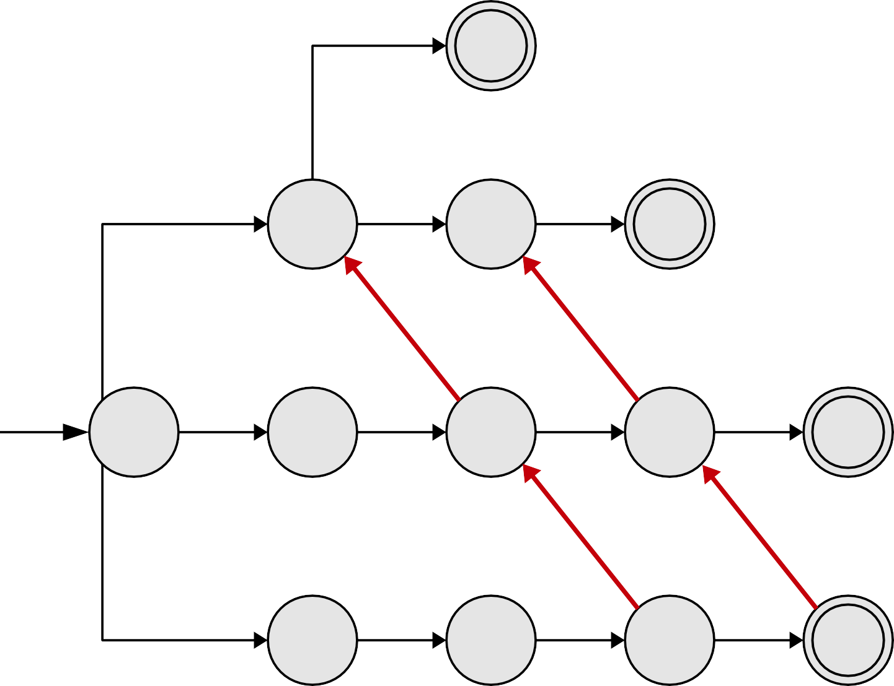
Pattern Strings
t
a | t
a | r | t
o | a | r | s
s | o | a | r
a
r
t
o
a
r
s
s
o
a
r

Slide 48
More Examples …
Suffix links

Slide 49
Pattern Strings
t
a | t
a | r | t
o | a | r | s
s | o | a | r
a
r
t
o
a
r
s
s
o
a
r
s | o | a | r | s | o | a | r | s

Slide 50
Pattern Strings
t
a | t
a | r | t
o | a | r | s
s | o | a | r
a
r
t
o
a
r
s
s
o
a
r
s | o | a | r | s | o | a | r | s

Slide 51
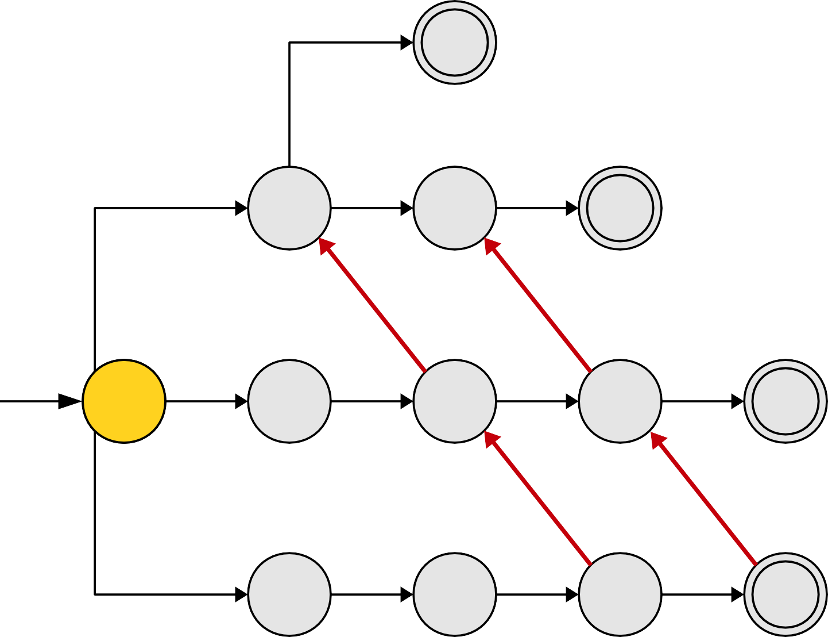
Pattern Strings
t
a | t
a | r | t
o | a | r | s
s | o | a | r
a
r
t
o
a
r
s
s
o
a
r
s | o | a | r | s | o | a | r | s

Slide 52
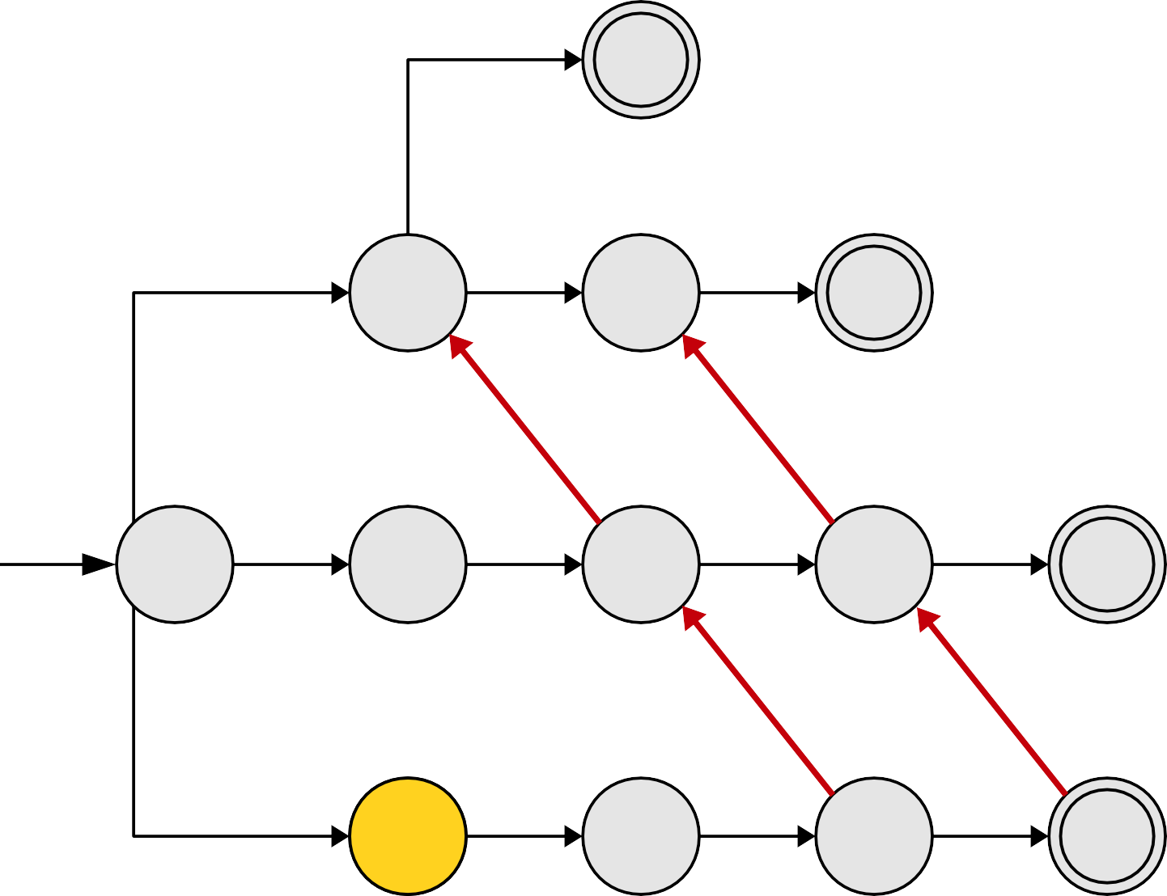
Pattern Strings
t
a | t
a | r | t
o | a | r | s
s | o | a | r
a
r
t
o
a
r
s
s
o
a
r
s | o | a | r | s | o | a | r | s

Slide 53
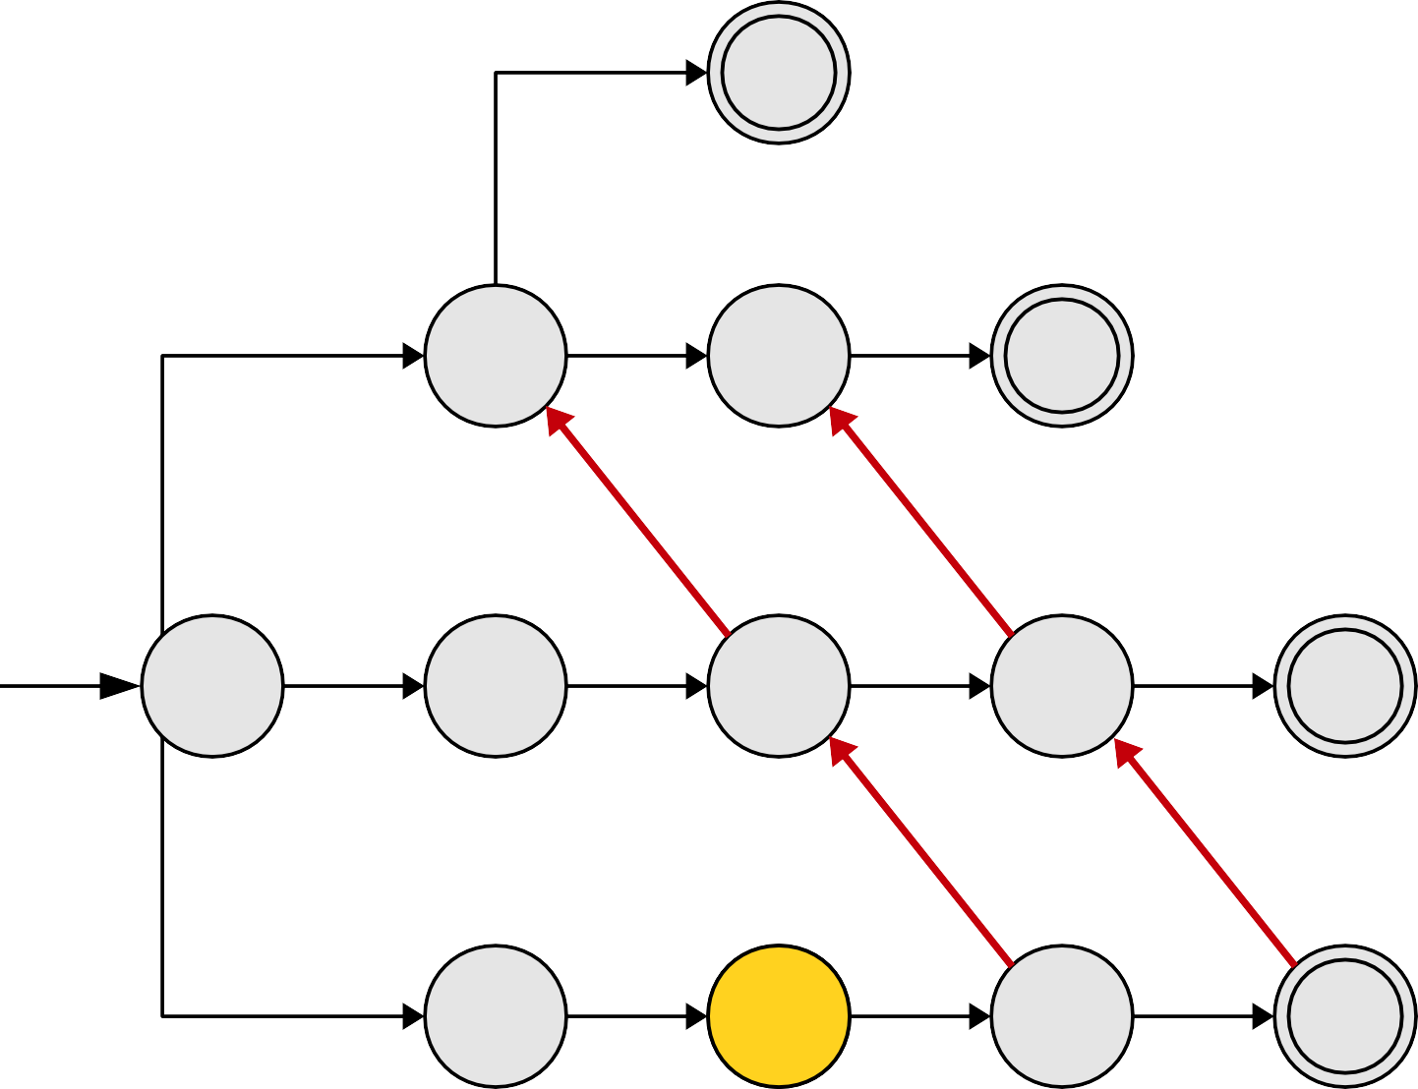
Pattern Strings
t
a | t
a | r | t
o | a | r | s
s | o | a | r
a
r
t
o
a
r
s
s
o
a
r
s | o | a | r | s | o | a | r | s

Slide 54
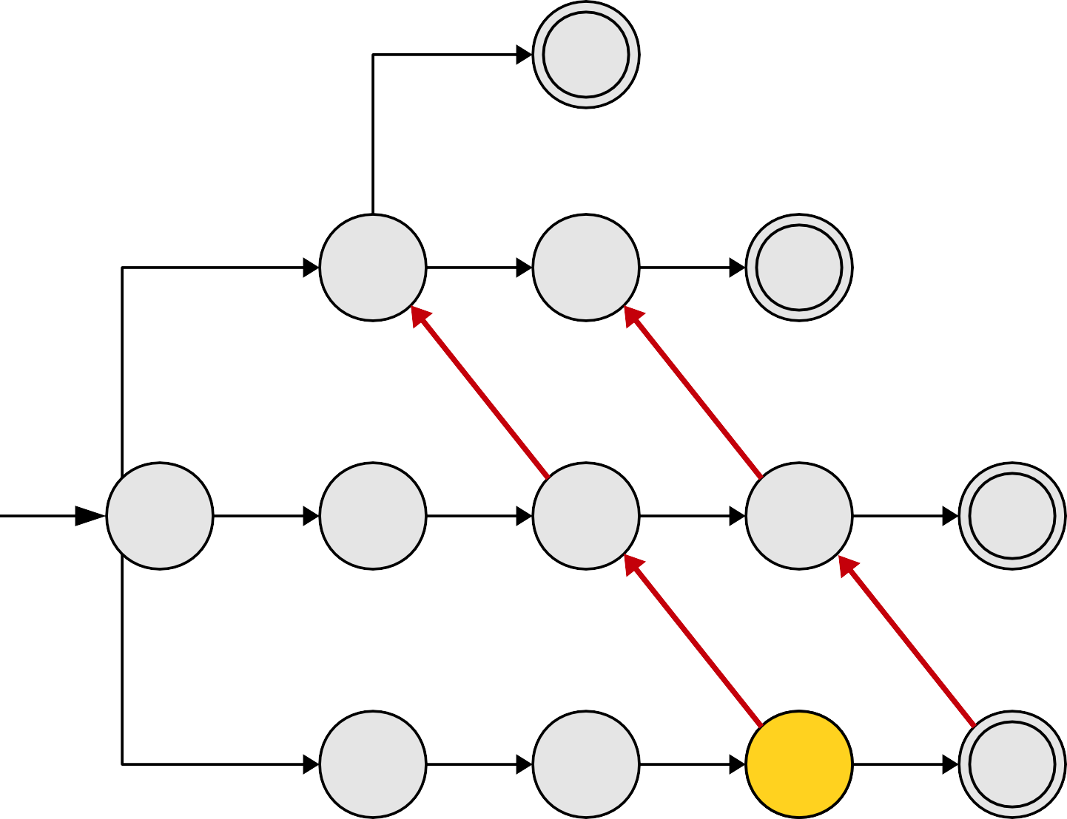
Pattern Strings
t
a | t
a | r | t
o | a | r | s
s | o | a | r
a
r
t
o
a
r
s
s
o
a
r
s | o | a | r | s | o | a | r | s

Slide 55
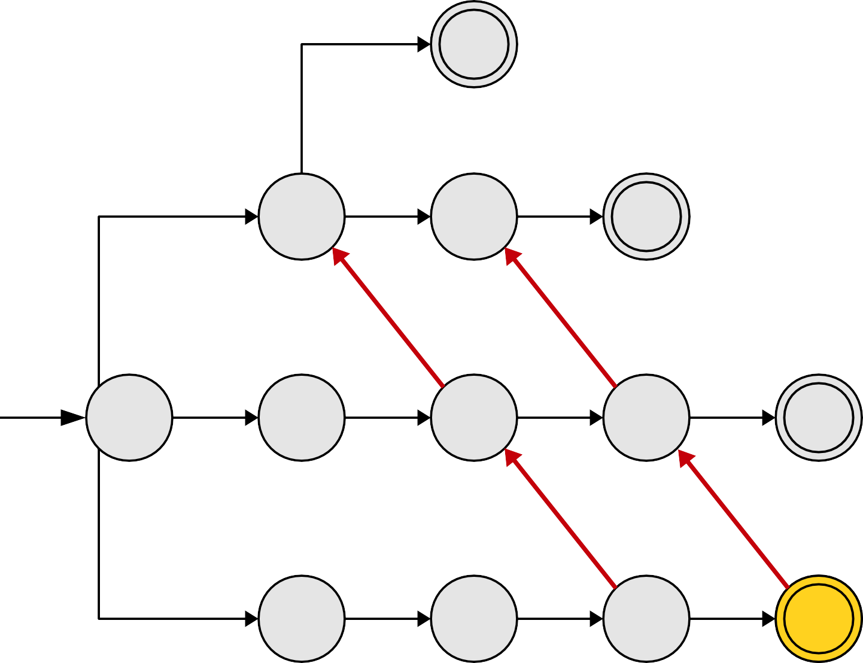
Pattern Strings
t
a | t
a | r | t
o | a | r | s
s | o | a | r
a
r
t
o
a
r
s
s
o
a
r
s | o | a | r | s | o | a | r | s

Slide 56
Pattern Strings
t
a | t
a | r | t
o | a | r | s
s | o | a | r
a
r
t
o
a
r
s
s
o
a
r
s | o | a | r | s | o | a | r | s

Slide 57
Pattern Strings
t
a | t
a | r | t
o | a | r | s
s | o | a | r
a
r
t
o
a
r
s
s
o
a
r
s | o | a | r | s | o | a | r | s

Slide 58
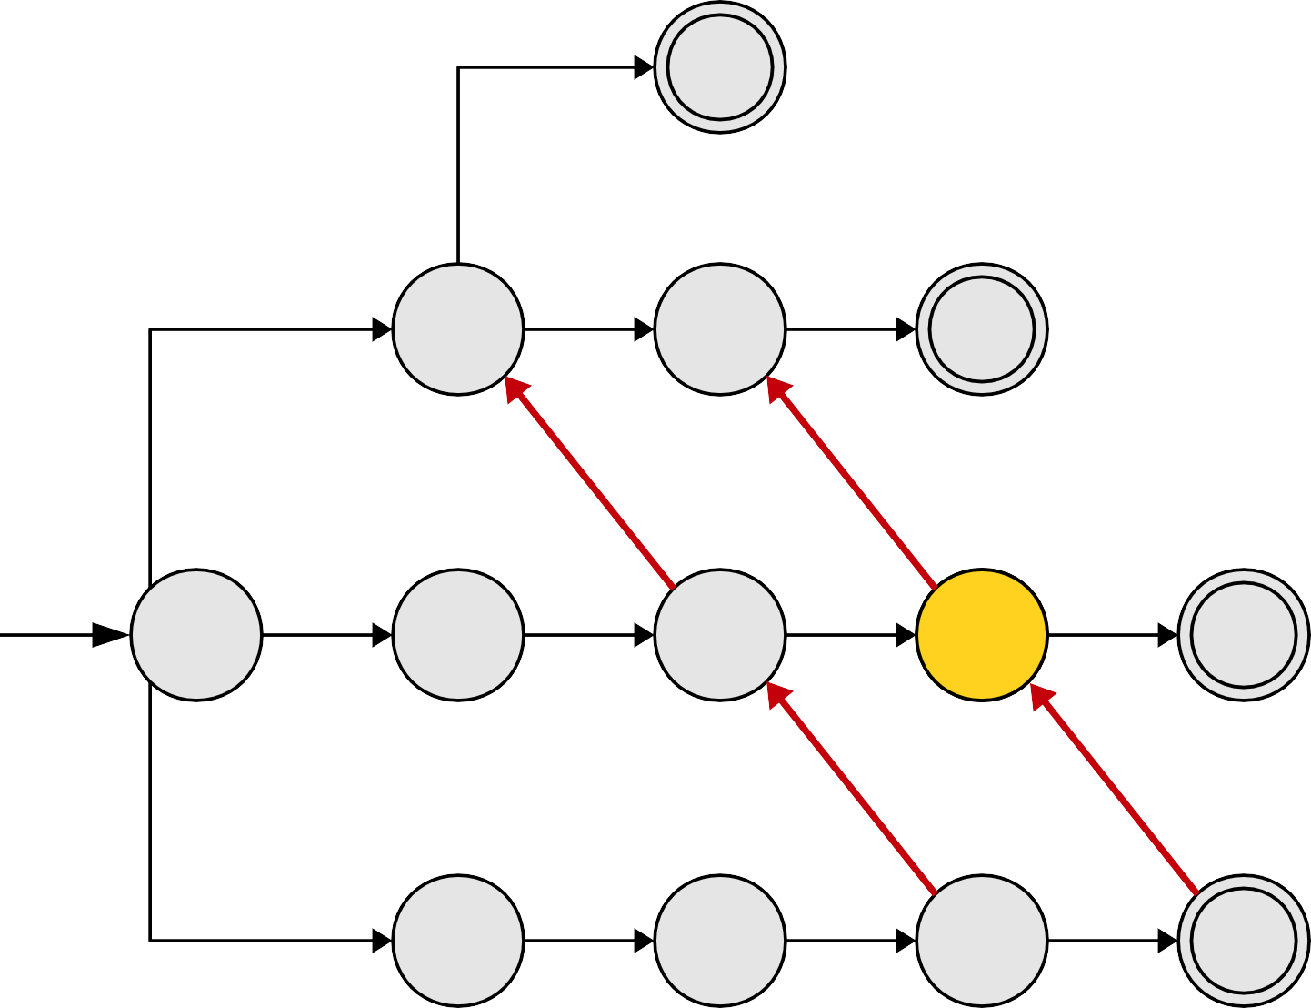
Pattern Strings
t
a | t
a | r | t
o | a | r | s
s | o | a | r
a
r
t
o
a
r
s
s
o
a
r
s | o | a | r | s | o | a | r | s

Slide 59
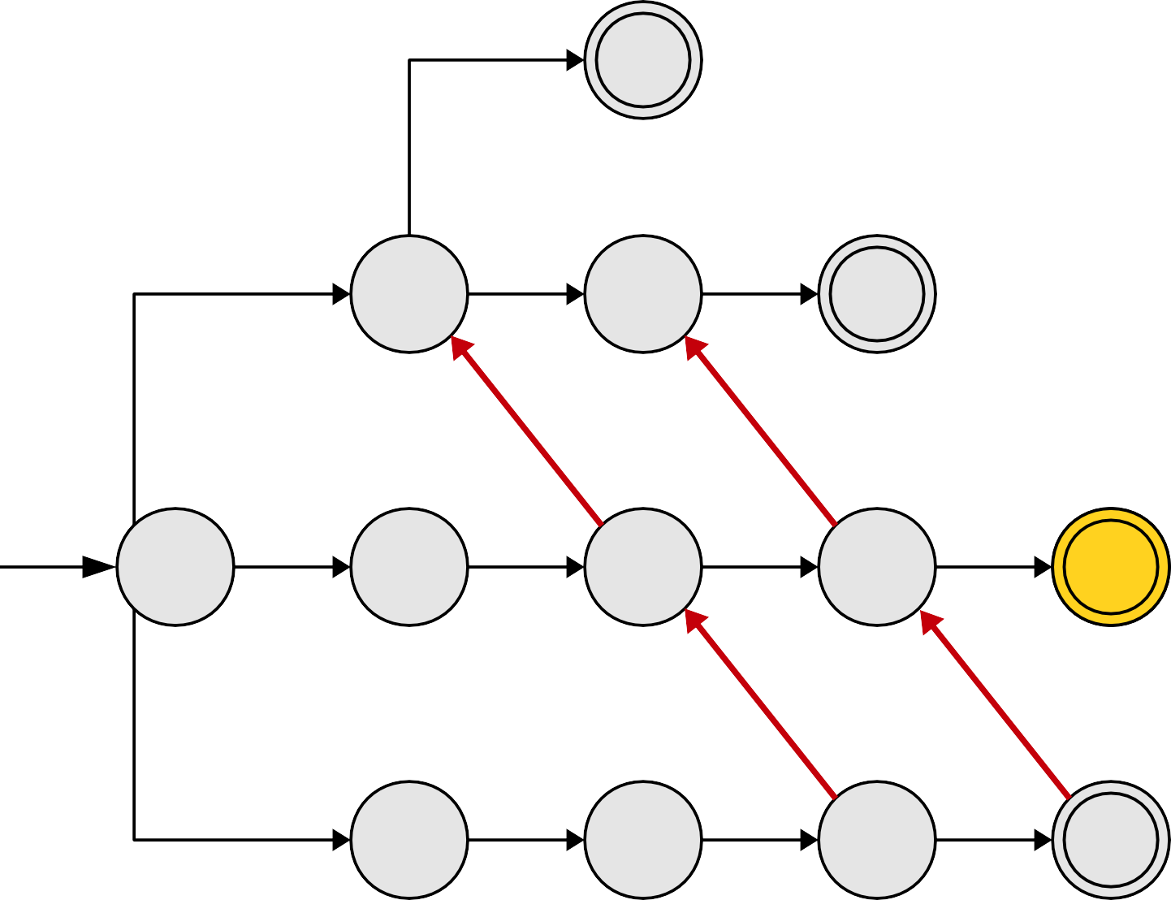
Pattern Strings
t
a | t
a | r | t
o | a | r | s
s | o | a | r
a
r
t
o
a
r
s
s
o
a
r
s | o | a | r | s | o | a | r | s

Slide 60
Pattern Strings
t
a | t
a | r | t
o | a | r | s
s | o | a | r
a
r
t
o
a
r
s
s
o
a
r
s | o | a | r | s | o | a | r | s

Slide 61
Pattern Strings
t
a | t
a | r | t
o | a | r | s
s | o | a | r
a
r
t
o
a
r
s
s
o
a
r
s | o | a | r | s | o | a | r | s

Slide 62
Pattern Strings
t
a | t
a | r | t
o | a | r | s
s | o | a | r
a
r
t
o
a
r
s
s
o
a
r
s | o | a | r | s | o | a | r | s

Slide 63
Pattern Strings
t
a | t
a | r | t
o | a | r | s
s | o | a | r
a
r
t
o
a
r
s
s
o
a
r
s | o | a | r | s | o | a | r | s

Slide 64
Pattern Strings
t
a | t
a | r | t
o | a | r | s
s | o | a | r
a
r
t
o
a
r
s
s
o
a
r
In general, suffix links might jump the red cursor forward more than one step. The number of steps taken is equal to the change of depth in the trie.
s | o | a | r | s | o | a | r | s

Slide 65
Pattern Strings
t
a | t
a | r | t
o | a | r | s
s | o | a | r
a
r
t
o
a
r
s
s
o
a
r
s | o | a | r | s | o | a | r | s

Slide 66
Pattern Strings
t
a | t
a | r | t
o | a | r | s
s | o | a | r
a
r
t
o
a
r
s
s
o
a
r
s | o | a | r | s | o | a | r | s

Slide 67
Pattern Strings
t
a | t
a | r | t
o | a | r | s
s | o | a | r
a
r
t
o
a
r
s
s
o
a
r
s | o | a | r | s | o | a | r | s

Slide 68
Pattern Strings
t
a | t
a | r | t
o | a | r | s
s | o | a | r
a
r
t
o
a
r
s
s
o
a
r
s | o | a | r | s | o | a | r | s

Slide 69
Pattern Strings
t
a | t
a | r | t
o | a | r | s
s | o | a | r
a
r
t
o
a
r
s
s
o
a
r
s | o | a | r | s | o | a | r | s

Slide 70
Pattern Strings
t
a | t
a | r | t
o | a | r | s
s | o | a | r
a
r
t
o
a
r
s
s
o
a
r
s | o | a | r | s | o | a | r | s

Slide 71
Pattern Strings
t
a | t
a | r | t
o | a | r | s
s | o | a | r
a
r
t
o
a
r
s
s
o
a
r
s | o | a | r | s | o | a | r | s

Slide 72
Pattern Strings
t
a | t
a | r | t
o | a | r | s
s | o | a | r
a
r
t
o
a
r
s
s
o
a
r
s | o | t | a | t

Slide 73
Pattern Strings
t
a | t
a | r | t
o | a | r | s
s | o | a | r
a
r
t
o
a
r
s
s
o
a
r
s | o | t | a | t

Slide 74
Pattern Strings
t
a | t
a | r | t
o | a | r | s
s | o | a | r
a
r
t
o
a
r
s
s
o
a
r
s | o | t | a | t

Slide 75
Pattern Strings
t
a | t
a | r | t
o | a | r | s
s | o | a | r
a
r
t
o
a
r
s
s
o
a
r
s | o | t | a | t

Slide 76
Pattern Strings
t
a | t
a | r | t
o | a | r | s
s | o | a | r
a
r
t
o
a
r
s
s
o
a
r
s | o | t | a | t

Slide 77
Pattern Strings
t
a | t
a | r | t
o | a | r | s
s | o | a | r
a
r
t
o
a
r
s
s
o
a
r
s | o | t | a | t

Slide 78
Pattern Strings
t
a | t
a | r | t
o | a | r | s
s | o | a | r
a
r
t
o
a
r
s
s
o
a
r
s | o | t | a | t

Slide 79
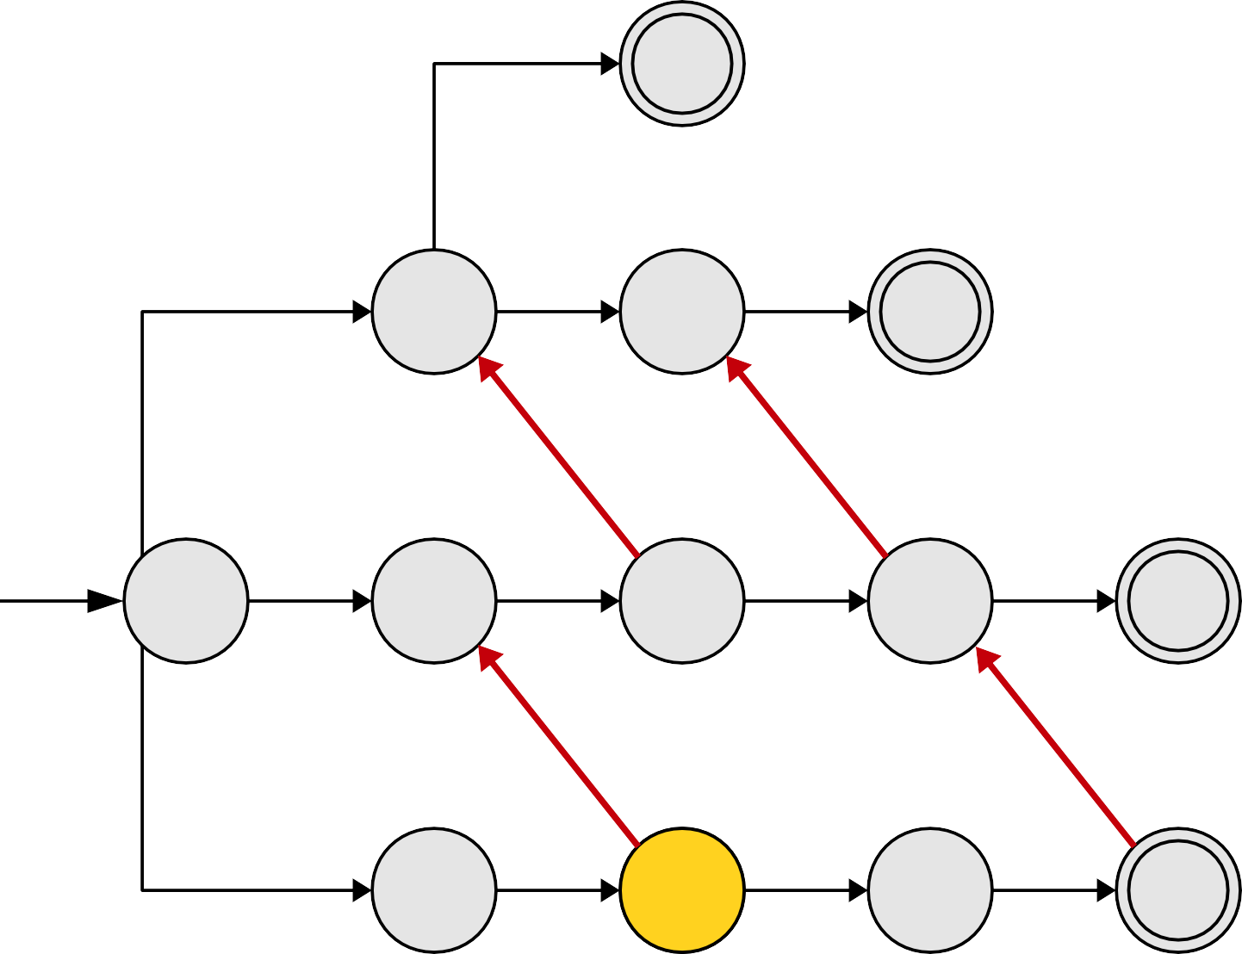
Pattern Strings
t
a | t
a | r | t
o | a | r | s
s | o | a | r
a
r
t
o
a
r
s
s
o
a
r
s | o | t | a | t

Slide 80
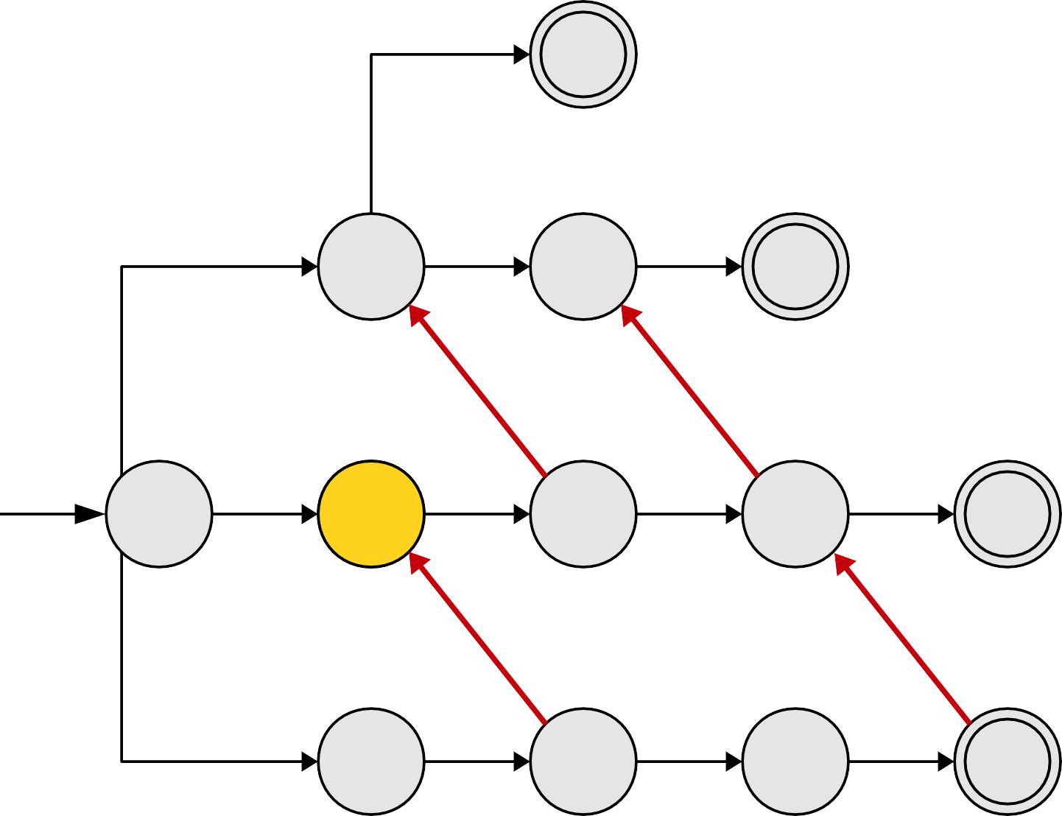
Pattern Strings
t
a | t
a | r | t
o | a | r | s
s | o | a | r
a
r
t
o
a
r
s
s
o
a
r
s | o | t | a | t

Slide 81
Pattern Strings
t
a | t
a | r | t
o | a | r | s
s | o | a | r
a
r
t
o
a
r
s
s
o
a
r
s | o | t | a | t

Slide 82
Pattern Strings
t
a | t
a | r | t
o | a | r | s
s | o | a | r
a
r
t
o
a
r
s
s
o
a
r
s | o | t | a | t

Slide 83
Pattern Strings
t
a | t
a | r | t
o | a | r | s
s | o | a | r
a
r
t
o
a
r
s
s
o
a
r
s | o | t | a | t

Slide 84
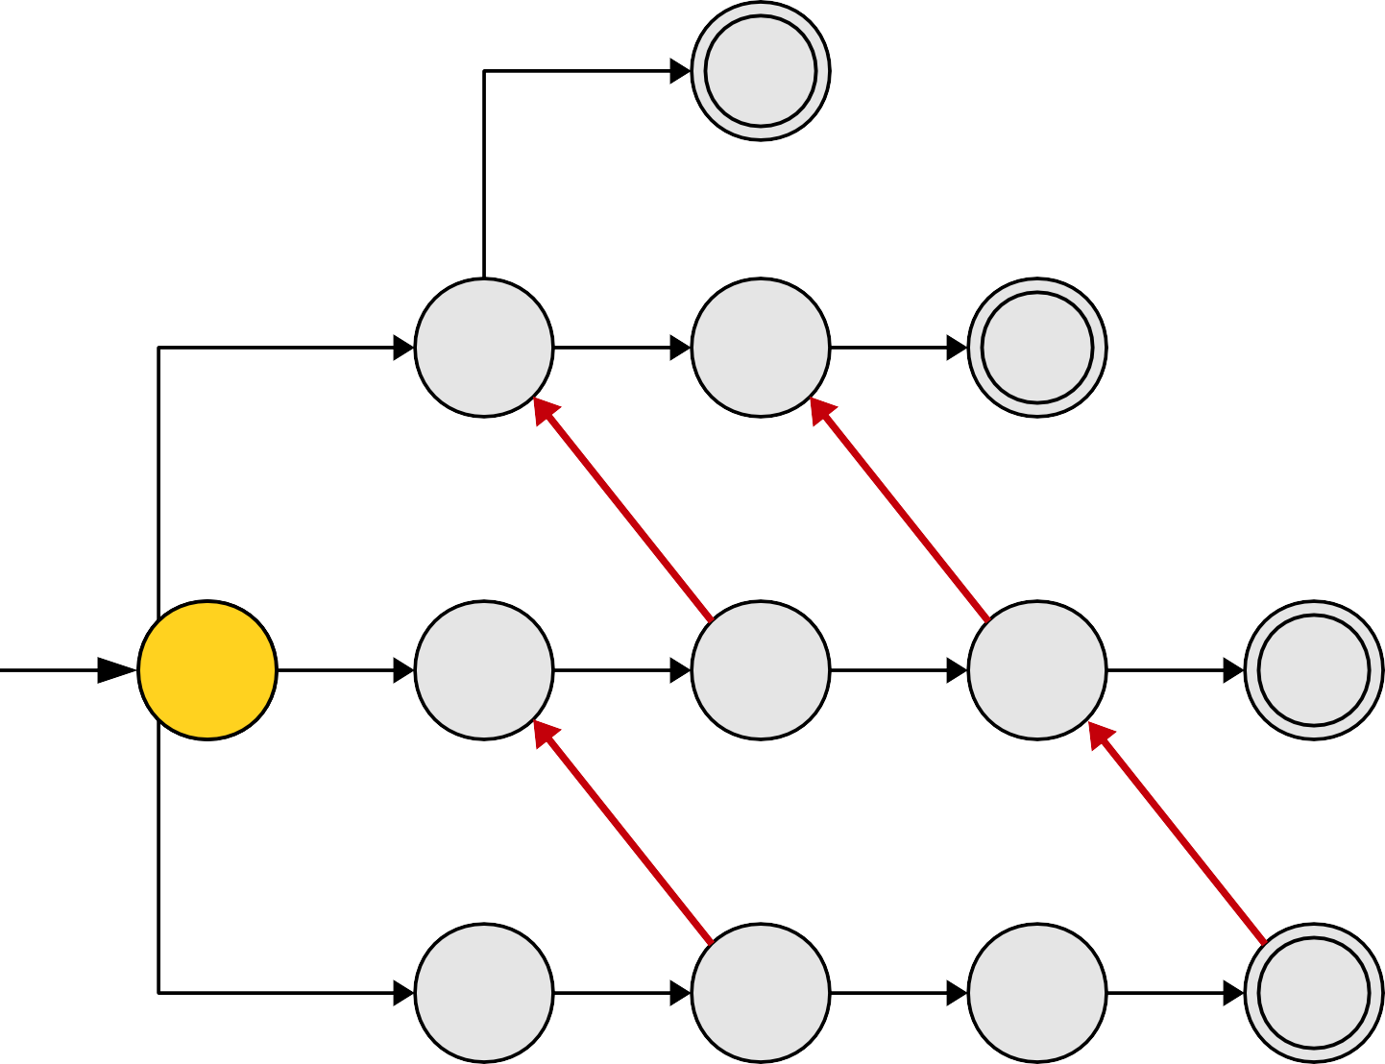
Pattern Strings
t
a | t
a | r | t
o | a | r | s
s | o | a | r
a
r
t
o
a
r
s
s
o
a
r
s | o | t | a | t

Slide 85
Pattern Strings
t
a | t
a | r | t
o | a | r | s
s | o | a | r
a
r
t
o
a
r
s
s
o
a
r
s | o | t | a | t

Slide 86
Pattern Strings
t
a | t
a | r | t
o | a | r | s
s | o | a | r
a
r
t
o
a
r
s
s
o
a
r
s | o | t | a | t

Slide 87
Pattern Strings
t
a | t
a | r | t
o | a | r | s
s | o | a | r
a
r
t
o
a
r
s
s
o
a
r
s | o | t | a | t

Slide 88
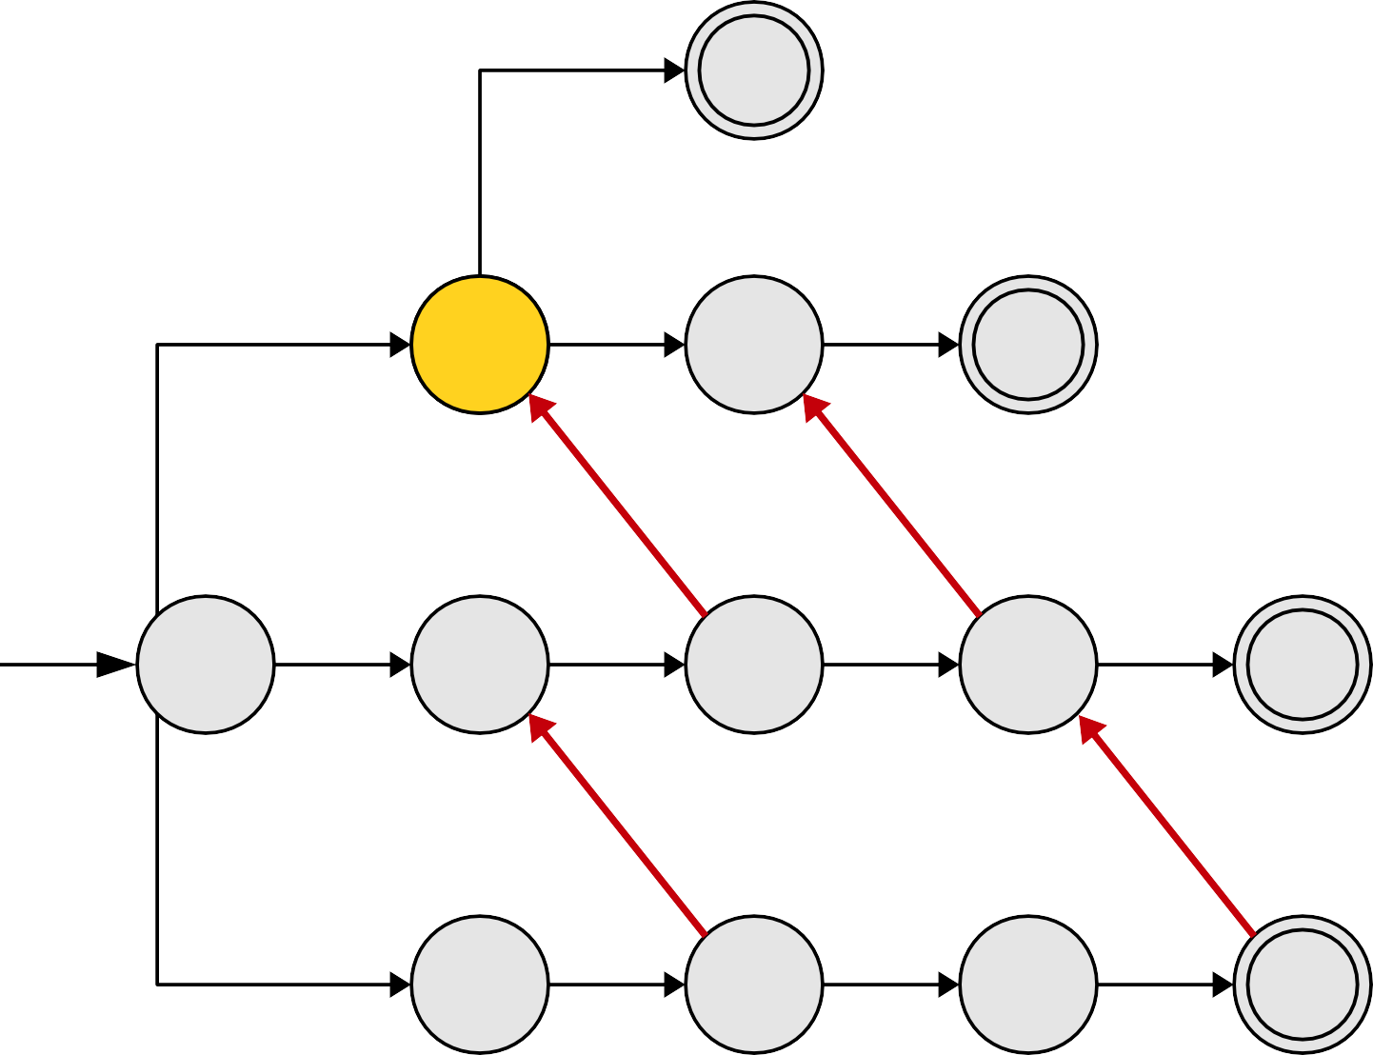
Pattern Strings
t
a | t
a | r | t
o | a | r | s
s | o | a | r
a
r
t
o
a
r
s
s
o
a
r
s | o | t | a | t

Slide 89
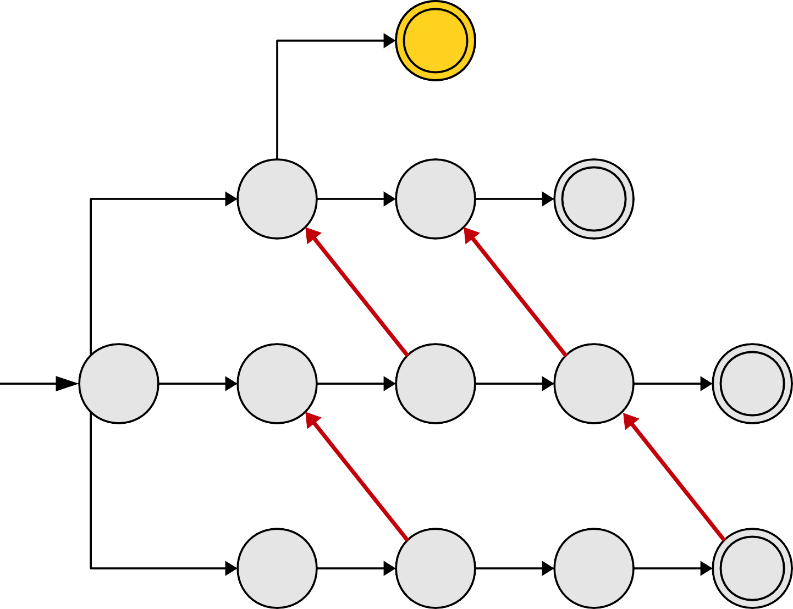
Pattern Strings
t
a | t
a | r | t
o | a | r | s
s | o | a | r
a
r
t
o
a
r
s
s
o
a
r
s | o | t | a | t

Slide 90
Suffix Links
●
A suffix link (sometimes called a failure link) is a red edge from a trie node corresponding to string α to the trie node corresponding to a string ω such that ω is the longest proper suffix of α that is still in the trie.
Intuition: When we hit a part of the string where we cannot continue to read characters, we fall back by following suffix links to try to preserve as much context as possible.
Every node in the trie, except the root (which corresponds to the empty string ε), will have a suffix link associated with it.
●
●

Slide 91
Why Suffix Links Matter
●
Suffix links can substantially improve the performance of our string search.
At each step, we either
●
advance the black (end) pointer forward in the trie, or advance the red (start) pointer forward.
●
●
Each pointer can advance forward at most O(m) times.
This reduces the amount of time spent scanning characters from O(mL_{max}) down to Θ(m).
This is only useful if we can compute suffix links quickly... which we'll see how to do later.
●
●
●

Slide 92
A Problem with our Optimization

Slide 93
Pattern Strings
i
i | n
t | i | n
s | t | i | n | g

Slide 94
Pattern Strings
i
i | n
t | i | n
s | t | i | n | g
i
n
t
i
n
s
t
i
n
g

Slide 95
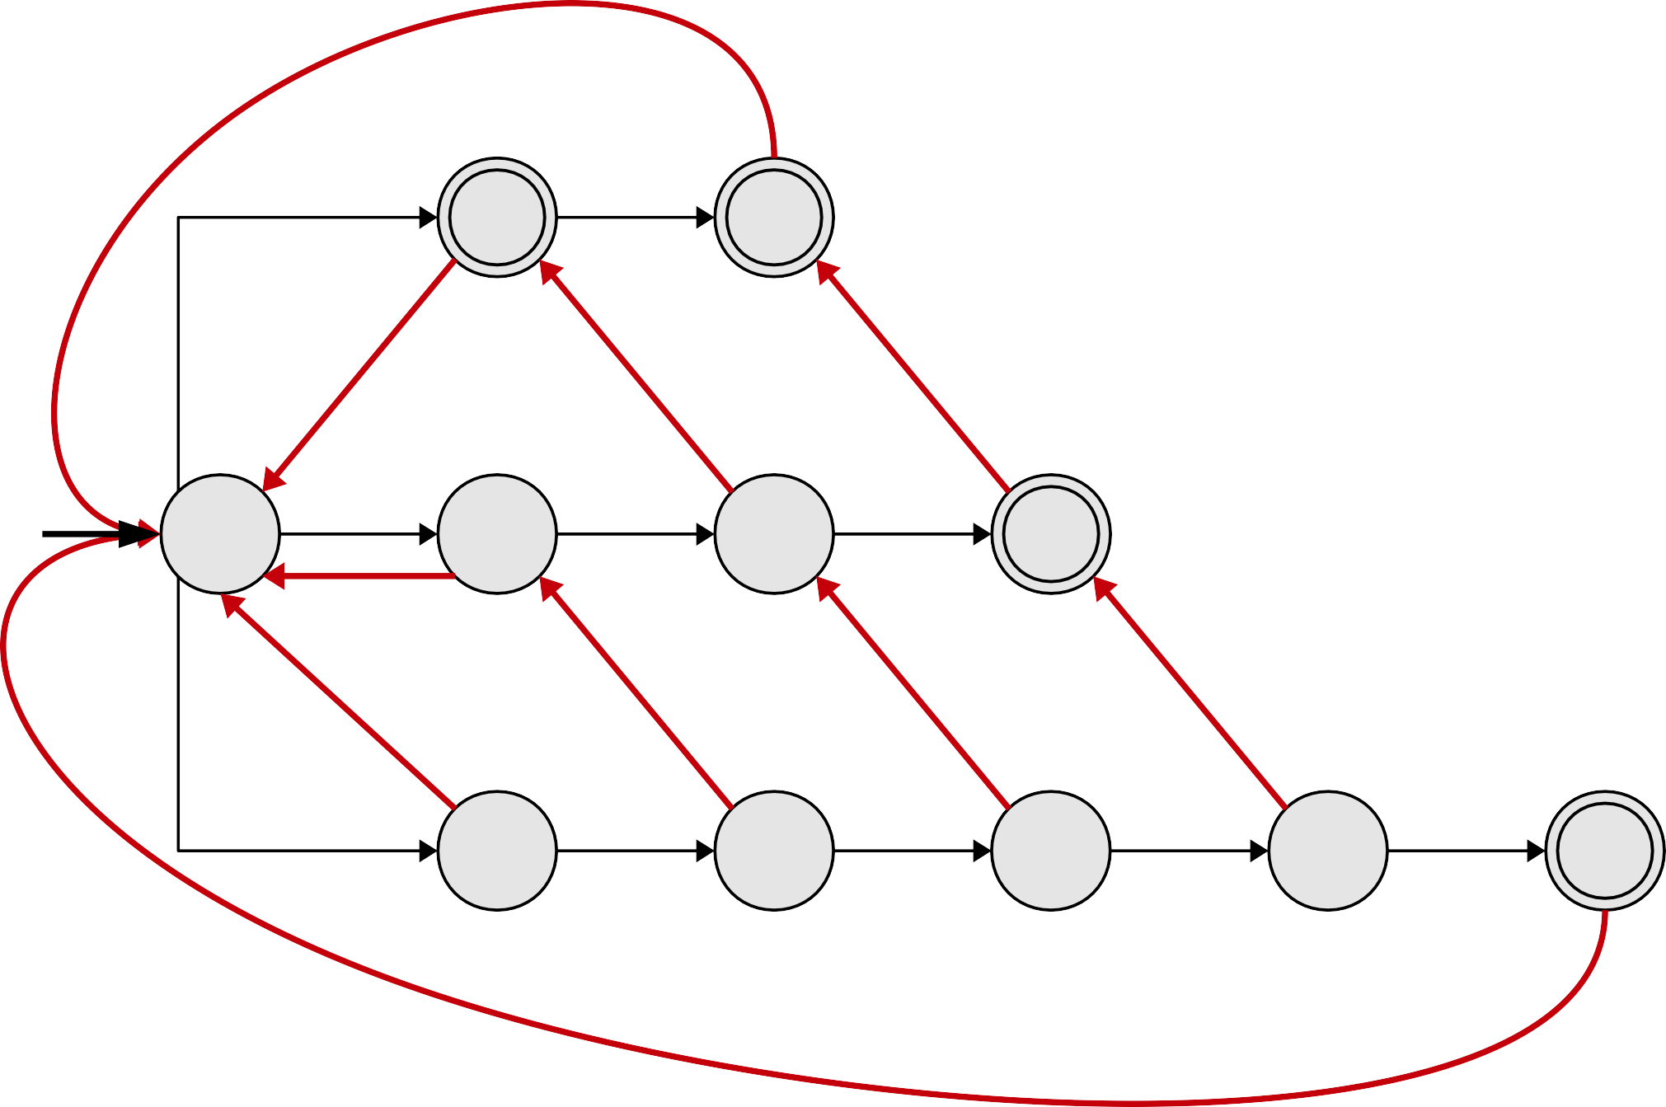
Pattern Strings
i
i | n
t | i | n
s | t | i | n | g
i
n
t
i
n
s
t
i
n
g

Slide 96
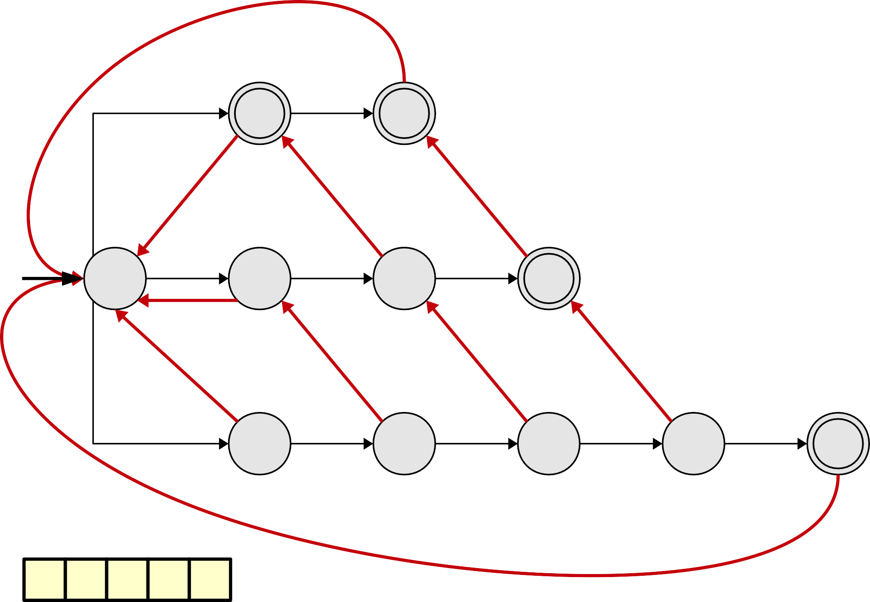
Pattern Strings
i
i | n
t | i | n
s | t | i | n | g
i
n
t
i
n
s
t
i
n
g
s
t
i
n
g

Slide 97
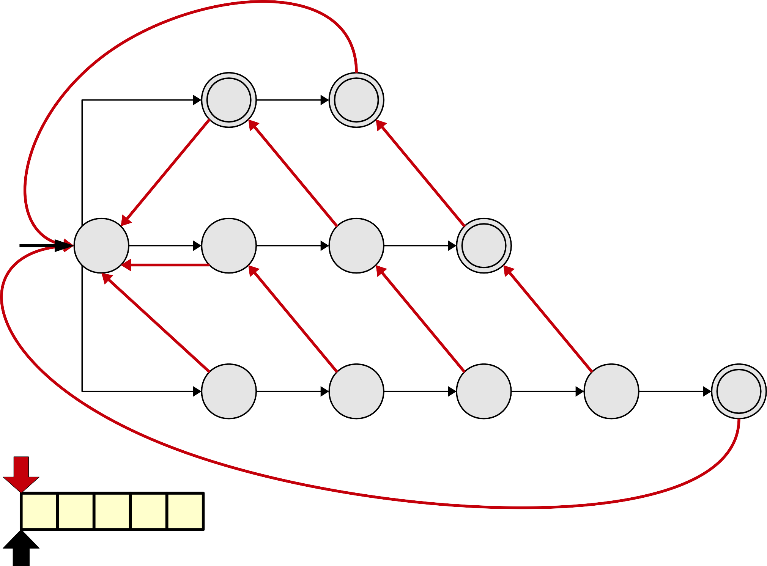
Pattern Strings
i
i | n
t | i | n
s | t | i | n | g
i
n
t
i
n
s
t
i
n
g
s
t
i
n
g

Slide 98
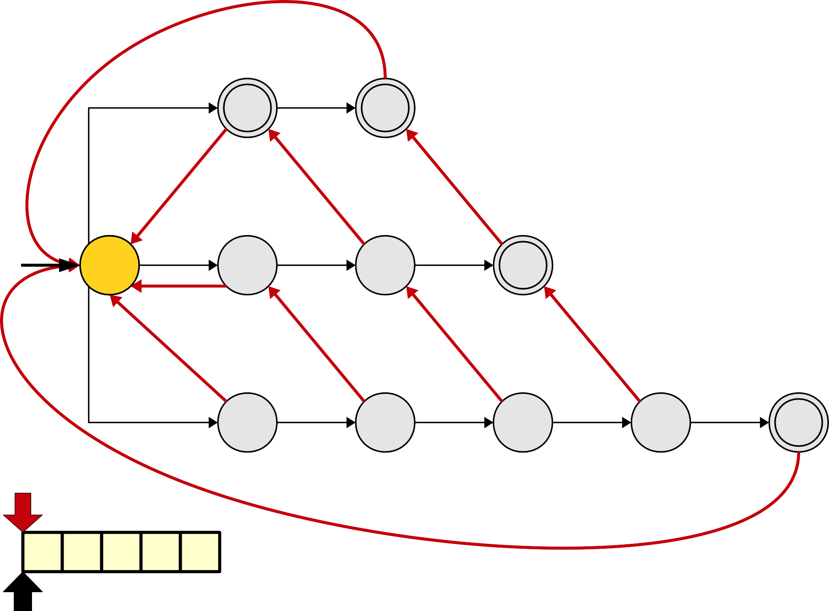
Pattern Strings
i
i | n
t | i | n
s | t | i | n | g
i
n
t
i
n
s
t
i
n
g
s
t
i
n
g

Slide 99
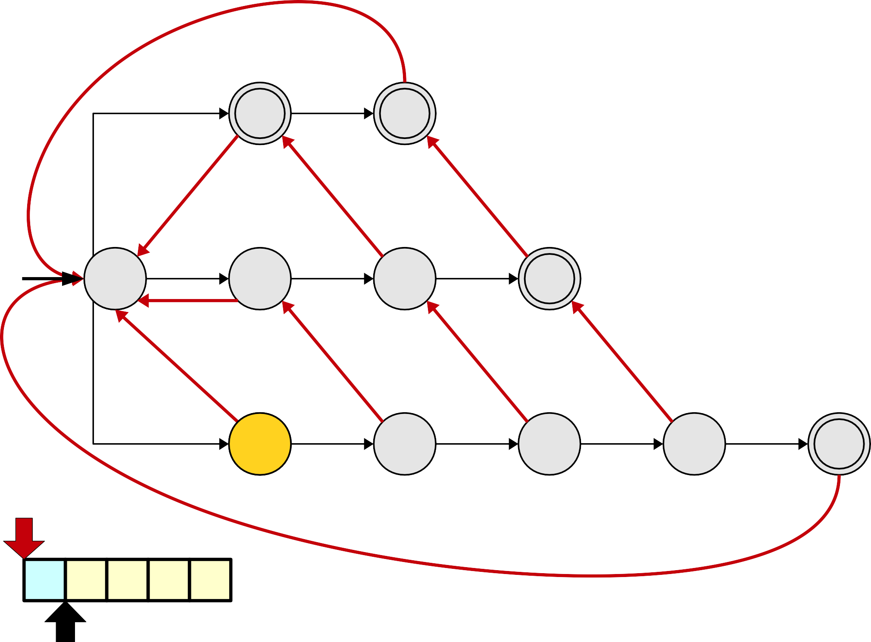
Pattern Strings
i
i | n
t | i | n
s | t | i | n | g
i
n
t
i
n
s
t
i
n
g
s
t
i
n
g

Slide 100
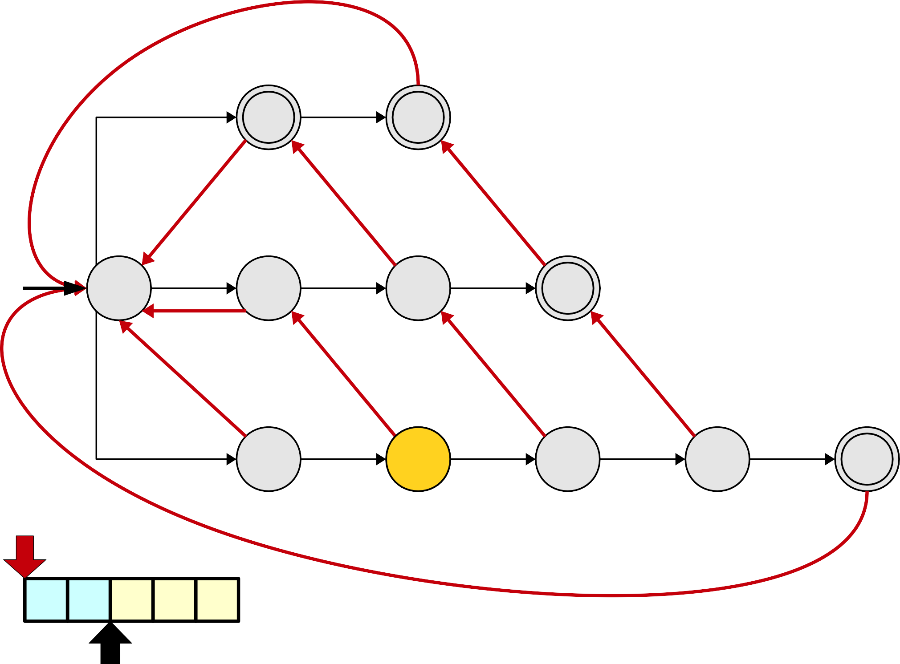
Pattern Strings
i
i | n
t | i | n
s | t | i | n | g
i
n
t
i
n
s
t
i
n
g
s
t
i
n
g

Slide 101
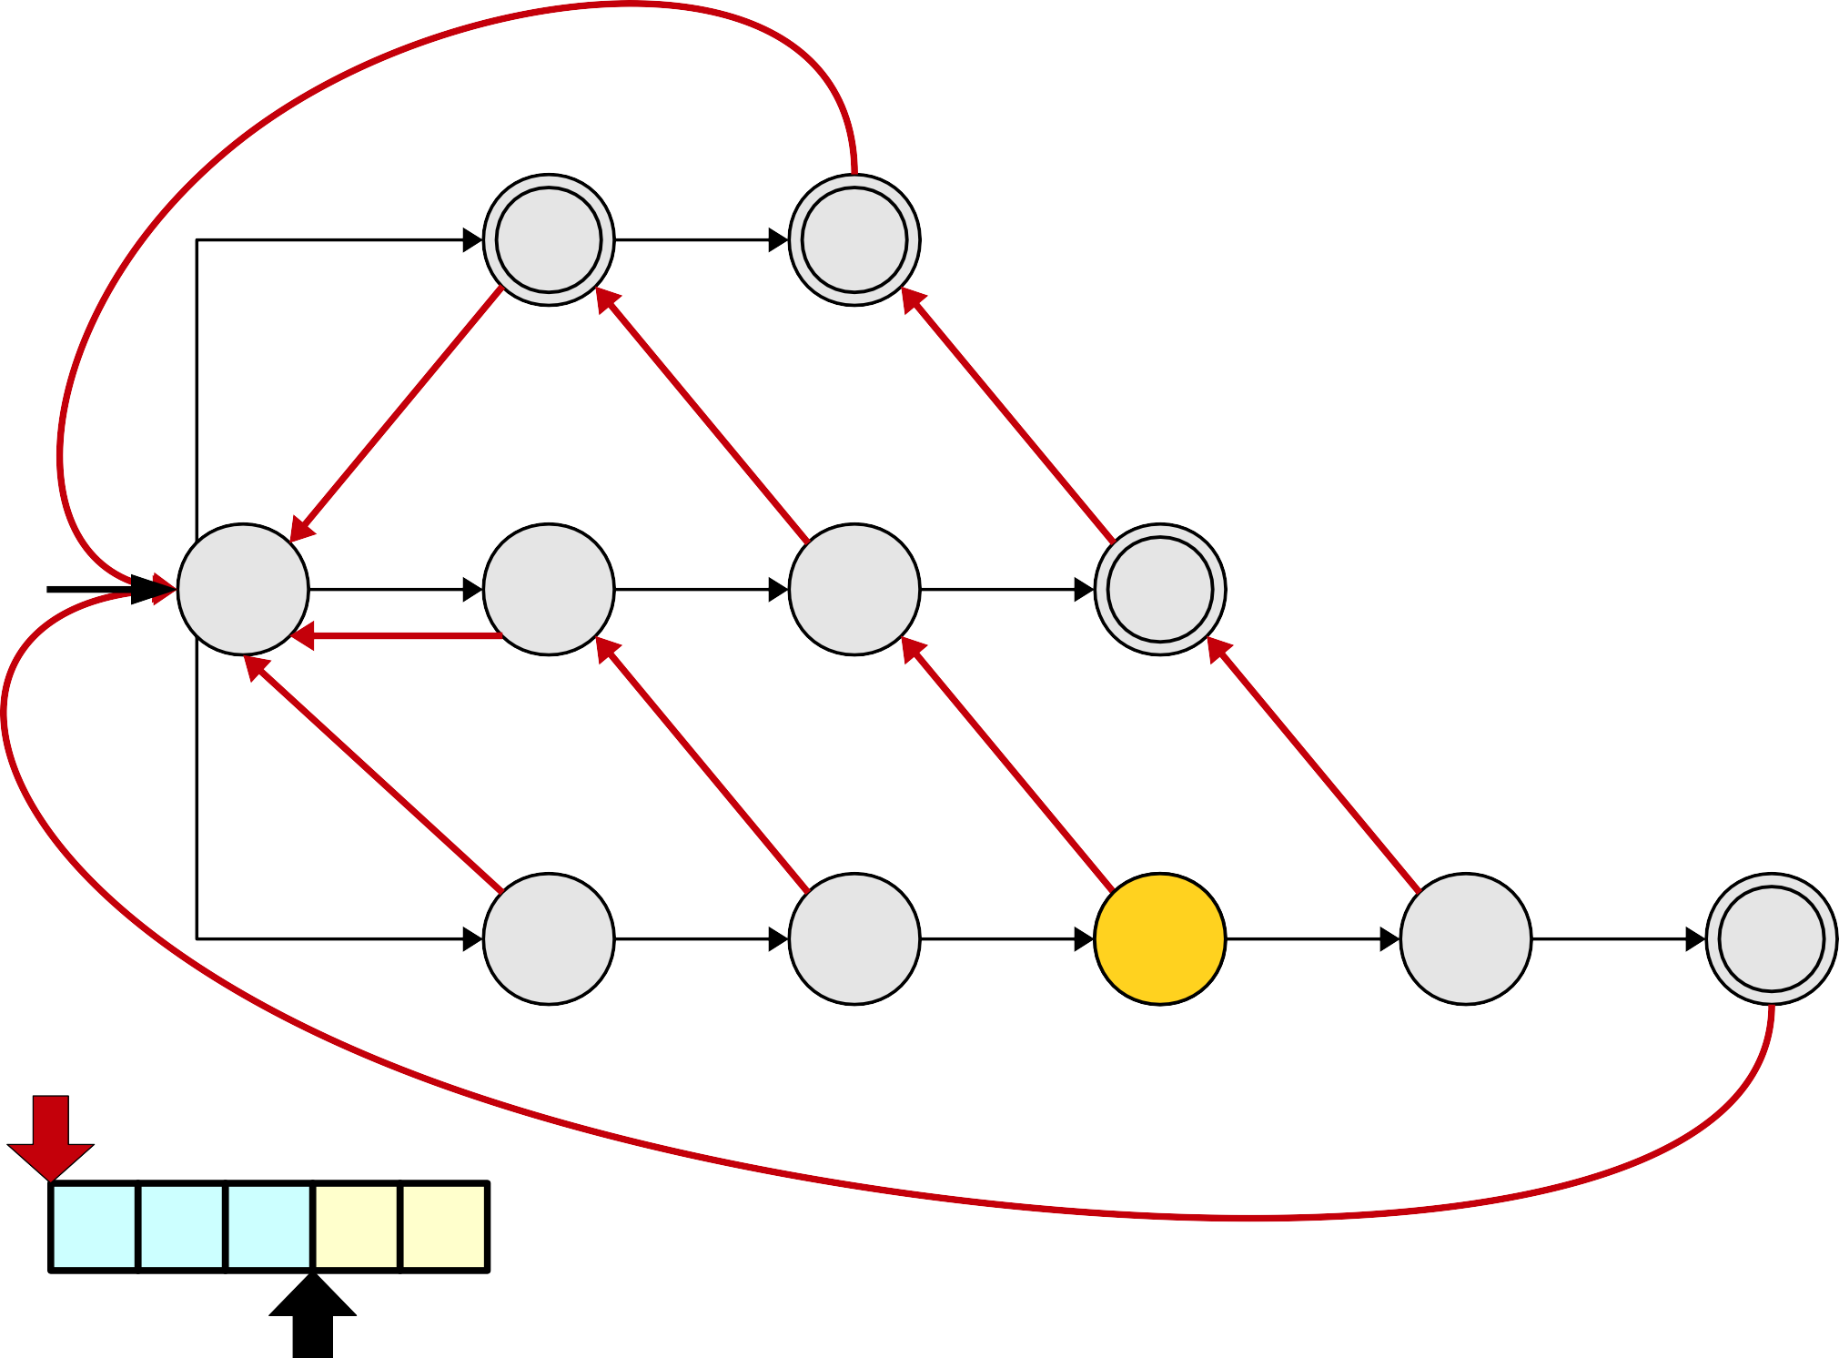
Pattern Strings
i
i | n
t | i | n
s | t | i | n | g
i
n
t
i
n
s
t
i
n
g
s
t
i
n
g

Slide 102
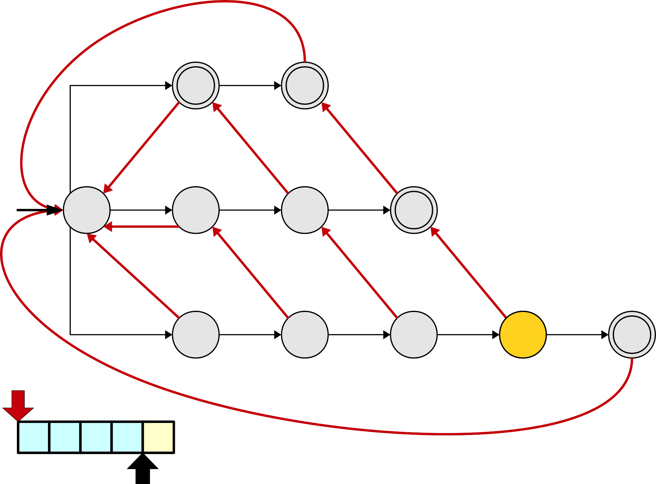
Pattern Strings
i
i | n
t | i | n
s | t | i | n | g
i
n
t
i
n
s
t
i
n
g
s
t
i
n
g

Slide 103
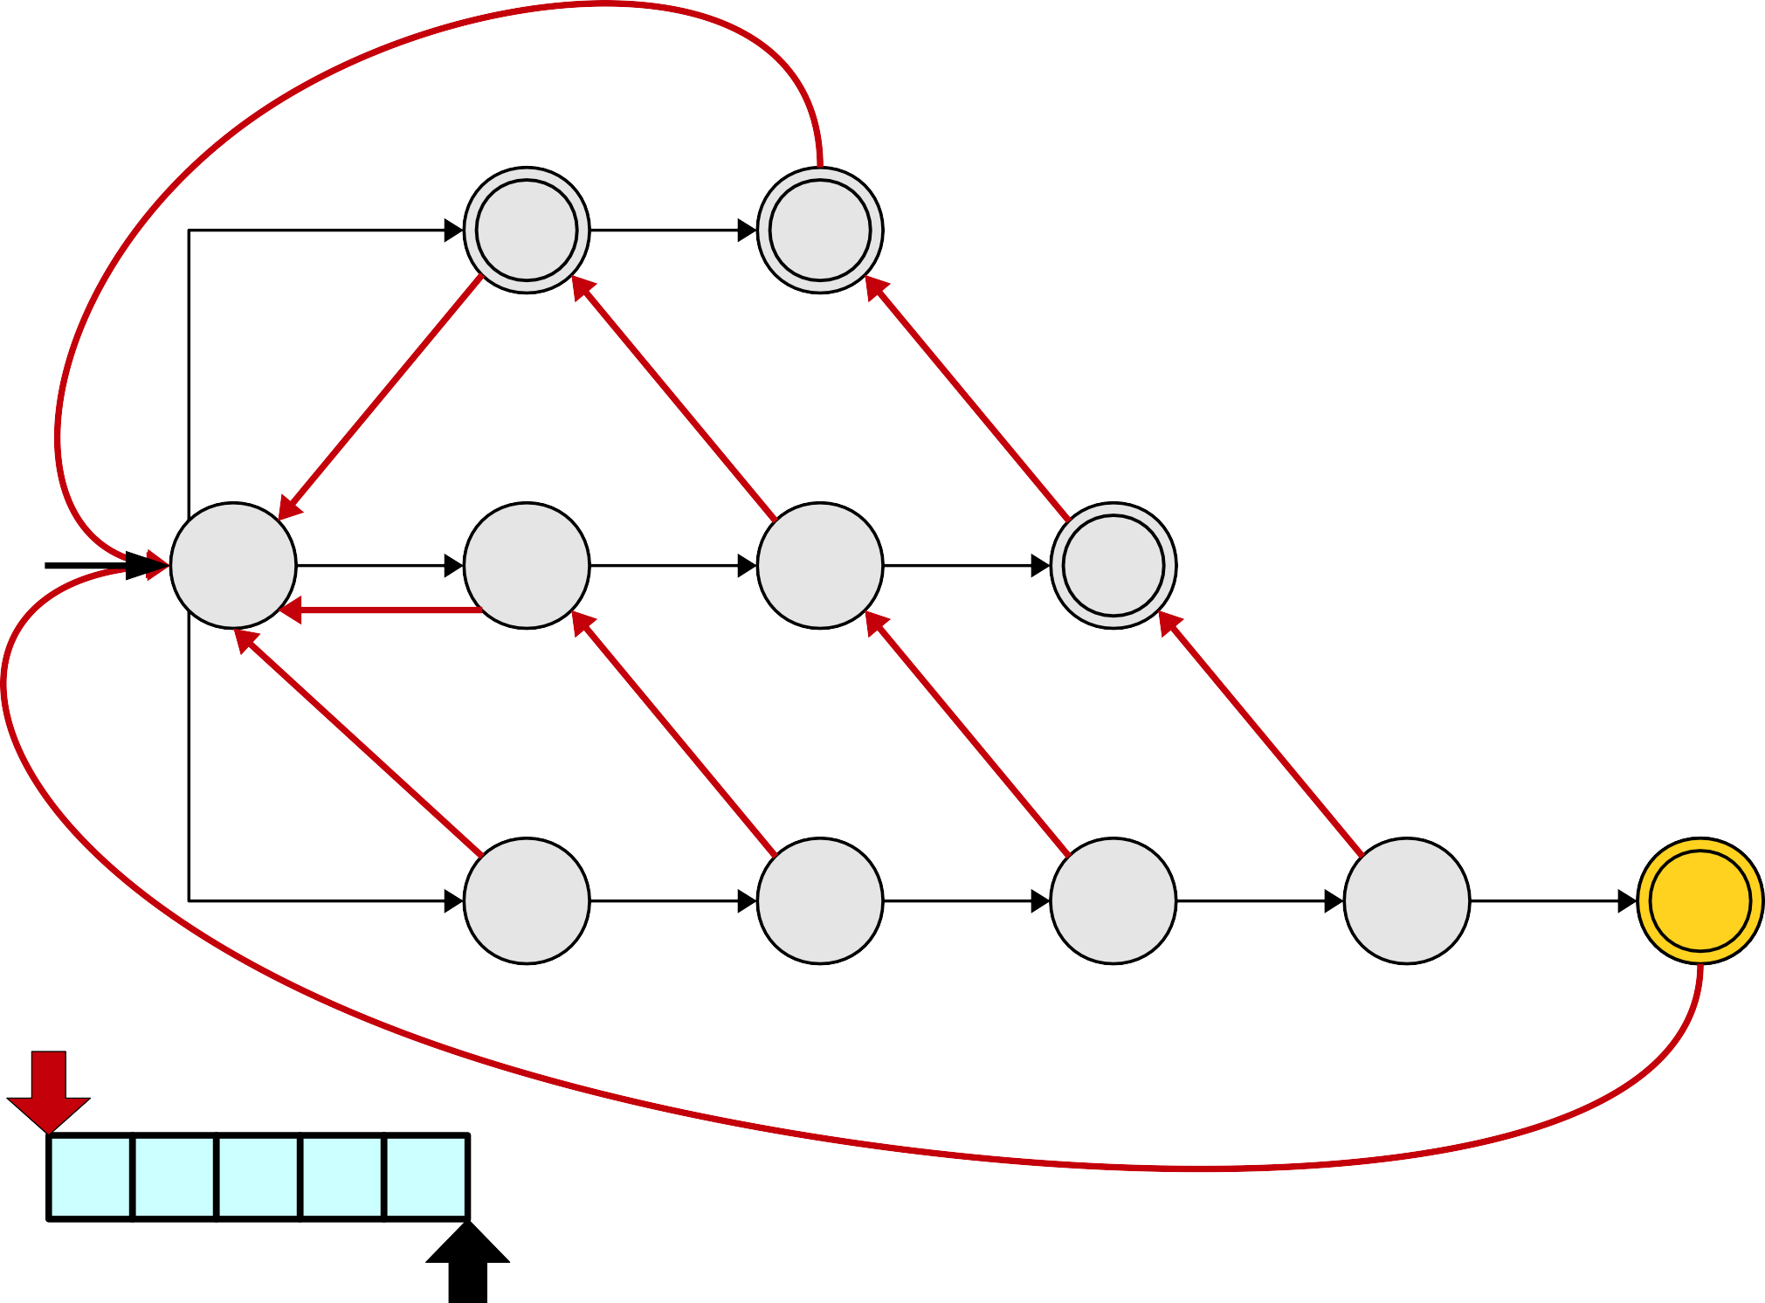
Pattern Strings
i
i | n
t | i | n
s | t | i | n | g
i
n
t
i
n
s
t
i
n
g
s
t
i
n
g

Slide 104
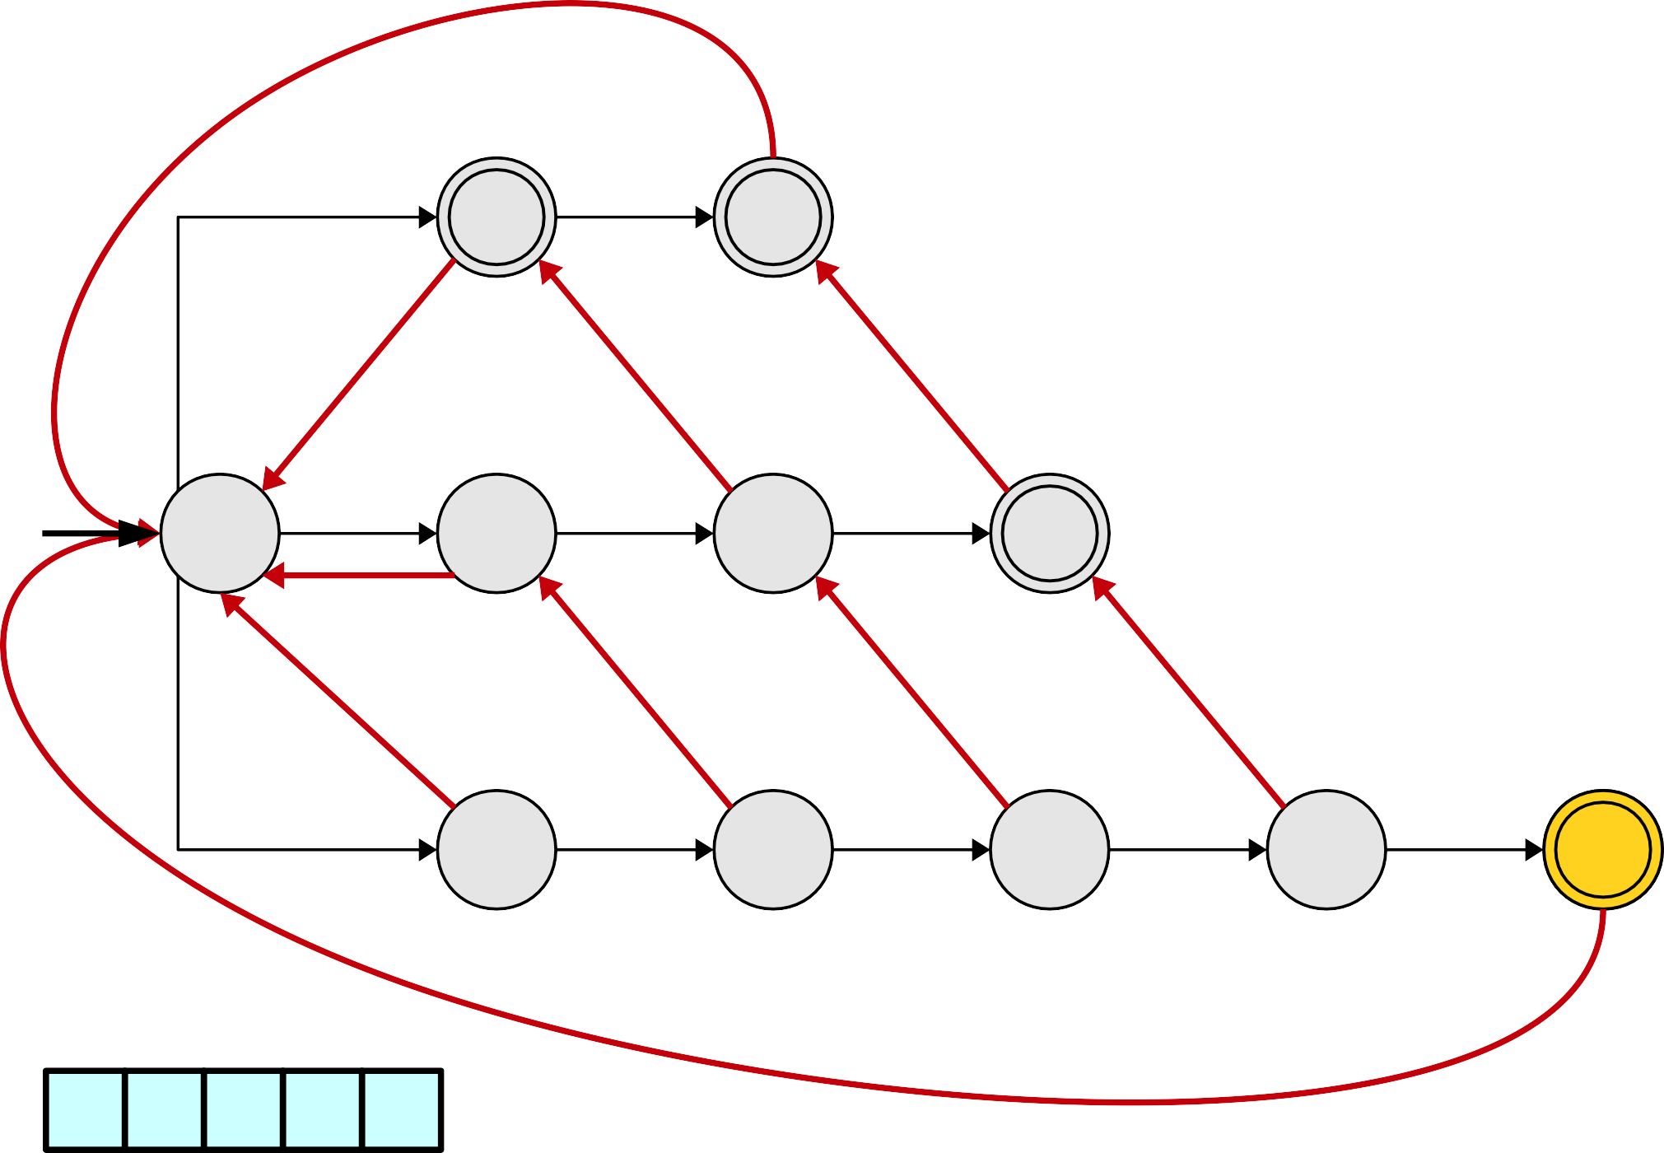
Pattern Strings
i
i | n
t | i | n
s | t | i | n | g
i
n
t
i
n
s
t
i
n
g
s
t
i
n
g

Slide 105
Pattern Strings
i
i | n
t | i | n
s | t | i | n | g
i
n
t
i
n
s
t
i
n
g
s
t
i
n
g

Slide 106
What Happened?
●
Our heavily optimized string searcher no longer starts searching from each position in the string.
As a result, we now might forget to output matches in certain cases.
We need to figure out
●
●
when this happens, and how to correct for it.
●
●

Slide 107
Pattern Strings
i
i | n
t | i | n
s | t | i | n | g
i
n
t
i
n
s
t
i
n
g
s
t
i
n
g

Slide 108
Pattern Strings
i
i | n
t | i | n
s | t | i | n | g
i
n
t
i
n
s
t
i
n
g
s
t
i
n
g

Slide 109
Pattern Strings
i
i | n
t | i | n
s | t | i | n | g
i
n
t
i
n
s
t
i
n
g
s
t
i
n
g

Slide 110
Pattern Strings
i
i | n
t | i | n
s | t | i | n | g
i
n
t
i
n
s
t
i
n
g
s
t
i
n
g

Slide 111
Pattern Strings
i
i | n
t | i | n
s | t | i | n | g
i
n
t
i
n
s
t
i
n
g
s
t
i
n
g

Slide 112
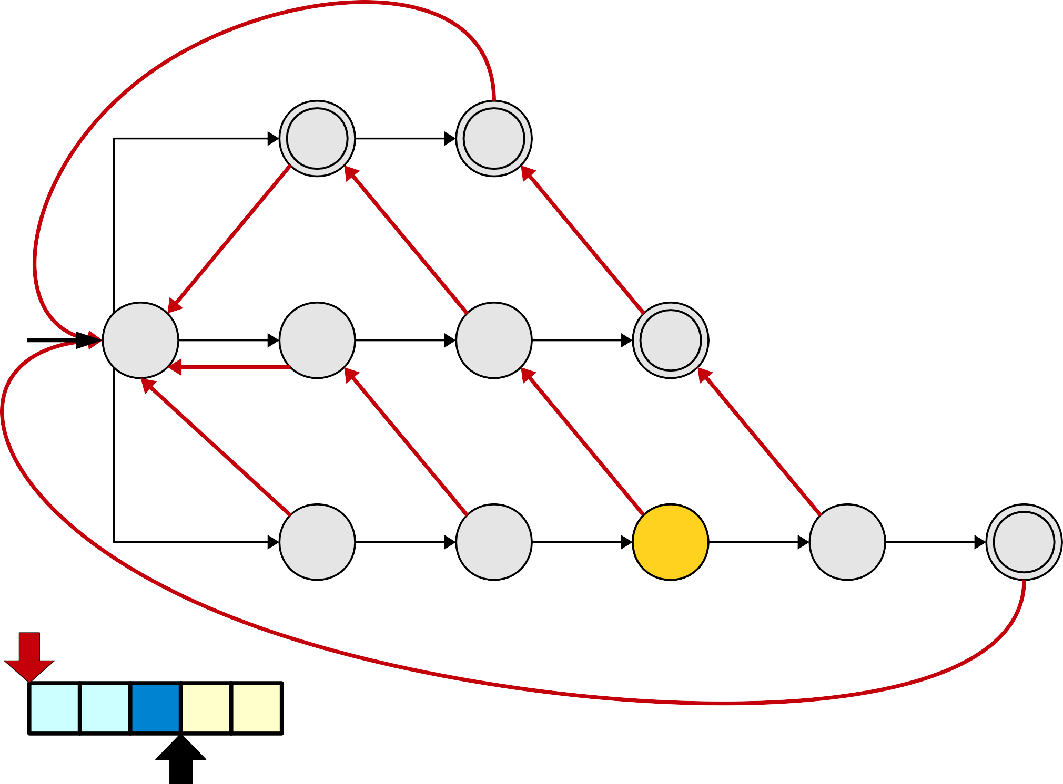
Pattern Strings
i
i | n
t | i | n
s | t | i | n | g
i
n
t
i
n
s
t
i
n
g
s
t
i
n
g

Slide 113
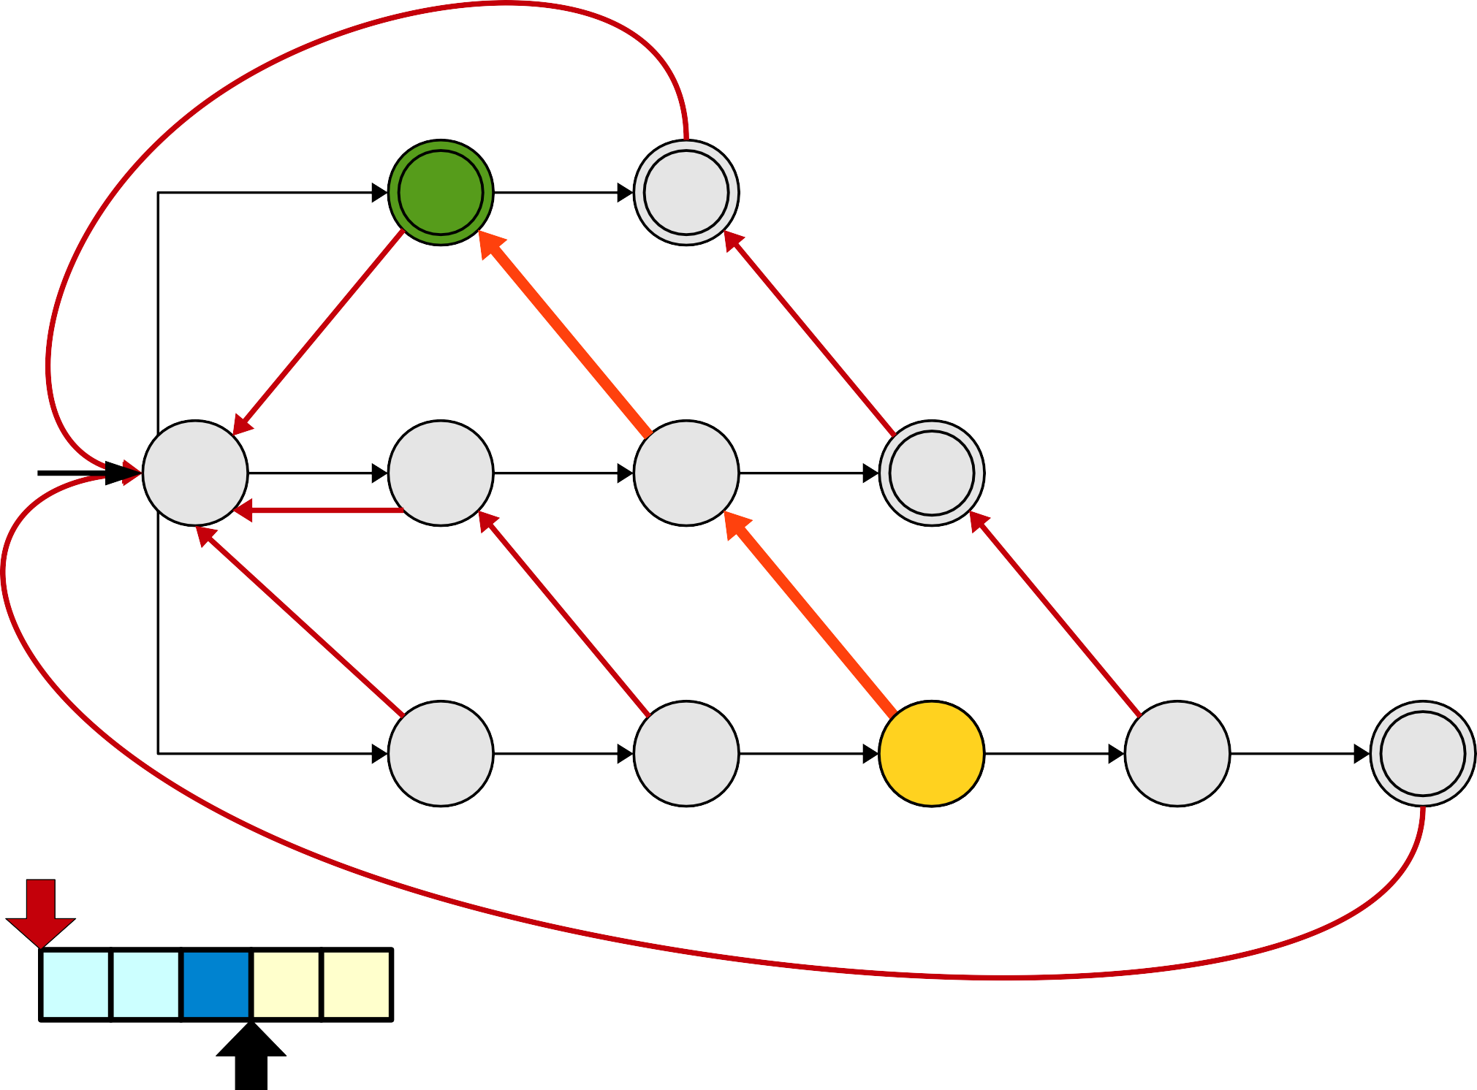
Pattern Strings
i
i | n
t | i | n
s | t | i | n | g
i
n
t
i
n
s
t
i
n
g
s
t
i
n
g

Slide 114
Pattern Strings
i
i | n
t | i | n
s | t | i | n | g
i
n
t
i
n
s
t
i
n
g
We missed the pattern string i
because it's a proper suffix sti.
s t i n g

Slide 115
Pattern Strings
i
i | n
t | i | n
s | t | i | n | g
i
n
t
i
n
s
t
i
n
g
s
t
i
n
g

Slide 116
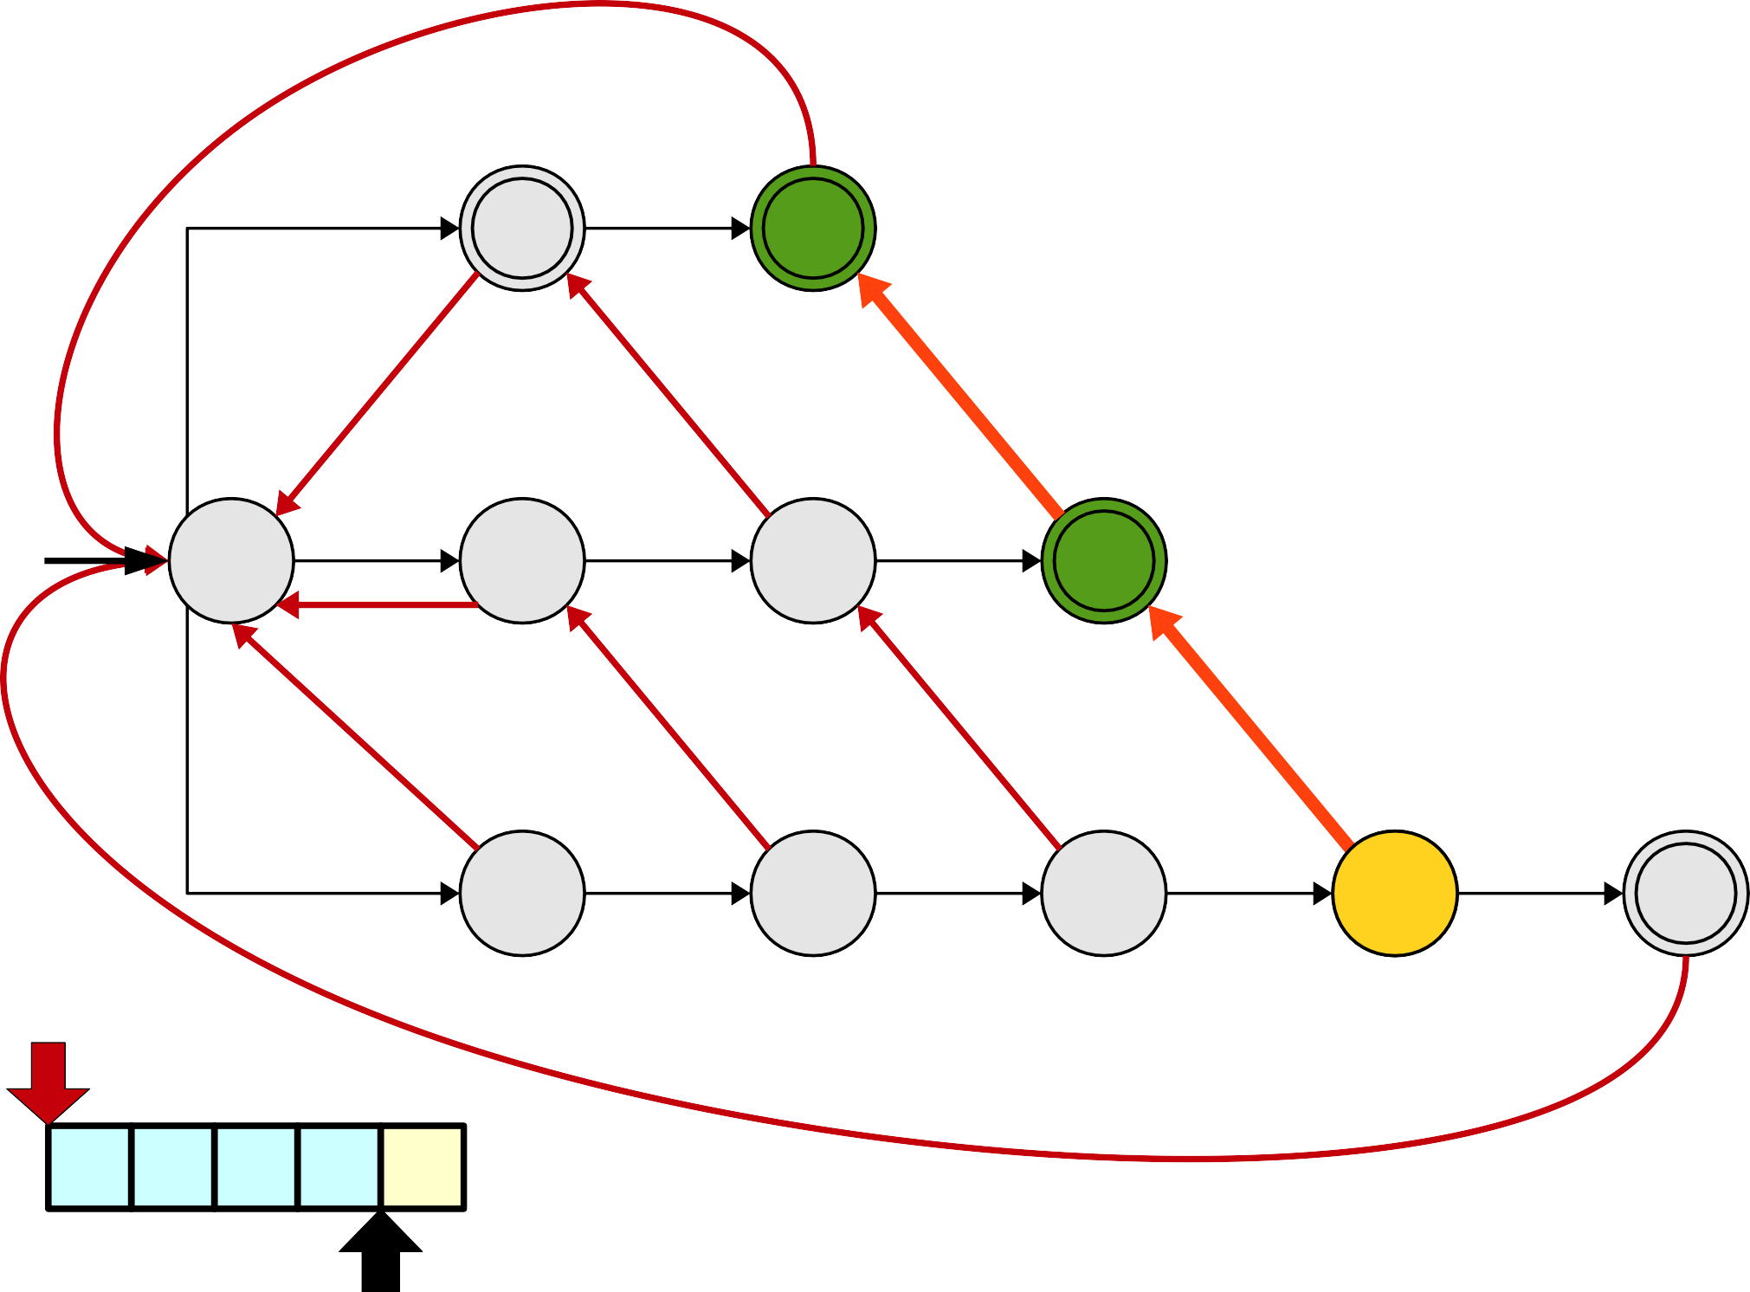
Pattern Strings
i
i | n
t | i | n
s | t | i | n | g
i
n
t
i
n
s
t
i
n
g
s
t
i
n
g

Slide 117
Pattern Strings
i
i | n
t | i | n
s | t | i | n | g
i
n
t
i
n
s
t
i
n
g
s t i n g
We missed both tin and in because each is a proper suffix of stin.

Slide 118
Pattern Strings
i
i | n
t | i | n
s | t | i | n | g
i
n
t
i
n
s
t
i
n
g
s
t
i
n
g

Slide 119
How do we address this?

Slide 120
Pattern Strings
i
i | n
t | i | n
s | t | i | n | g
i
n
t
i
n
s
t
i
n
g
s
t
i
n
g

Slide 121
Pattern Strings
i
i | n
t | i | n
s | t | i | n | g
i
n
t
i
n
s
t
i
n
g
s
t
i
n
g

Slide 122
Pattern Strings
i
i | n
t | i | n
s | t | i | n | g
i
n
t
i
n
s
t
i
n
g
s
t
i
n
g

Slide 123
Pattern Strings
i
i | n
t | i | n
s | t | i | n | g
i
n
t
i
n
s
t
i
n
g
s
t
i
n
g

Slide 124
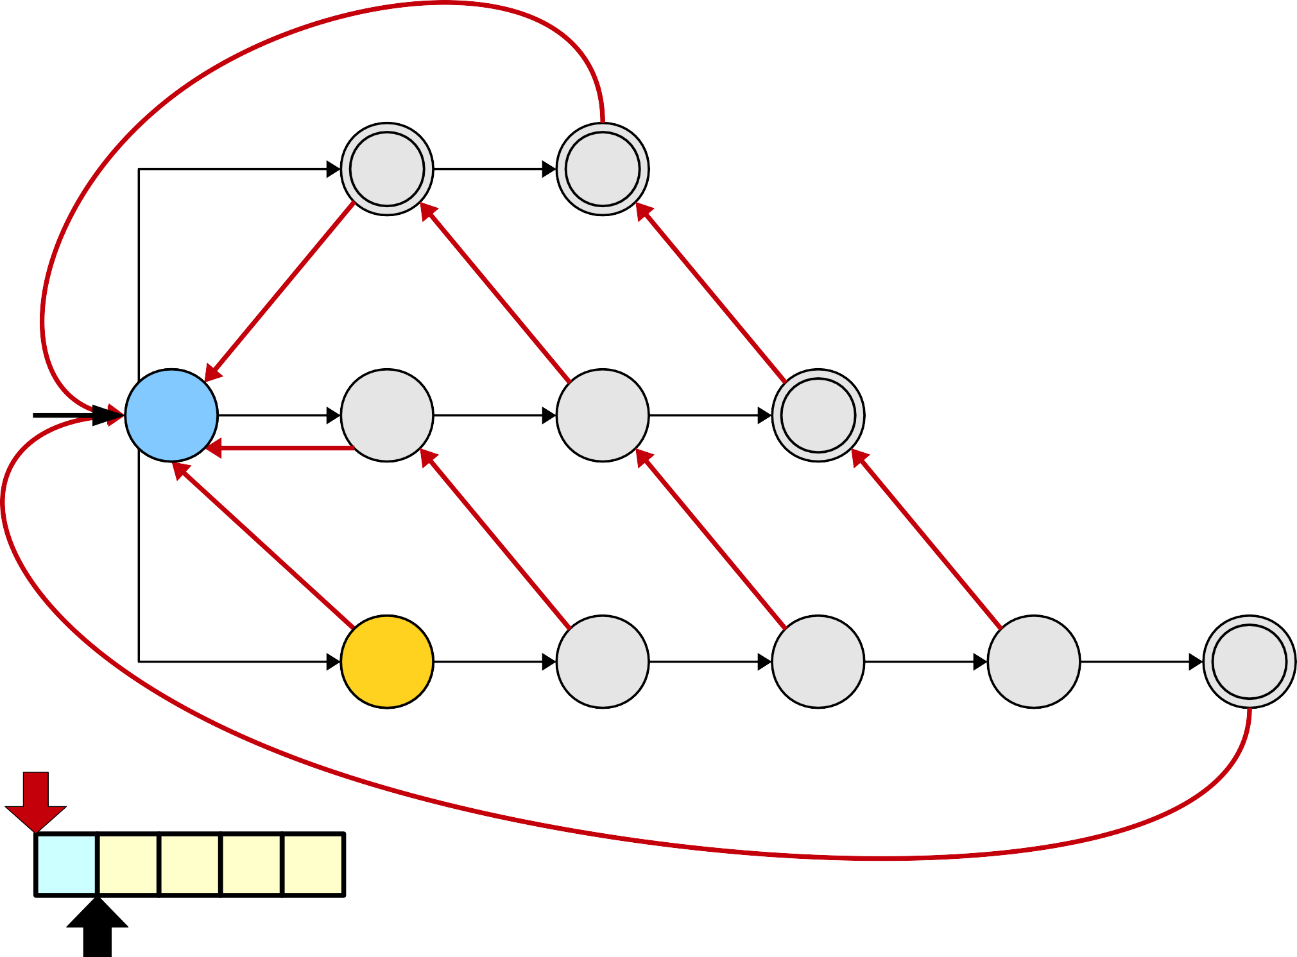
Pattern Strings
i
i | n
t | i | n
s | t | i | n | g
i
n
t
i
n
s
t
i
n
g
s
t
i
n
g

Slide 125
Pattern Strings
i
i | n
t | i | n
s | t | i | n | g
i
n
t
i
n
s
t
i
n
g
s
t
i
n
g

Slide 126
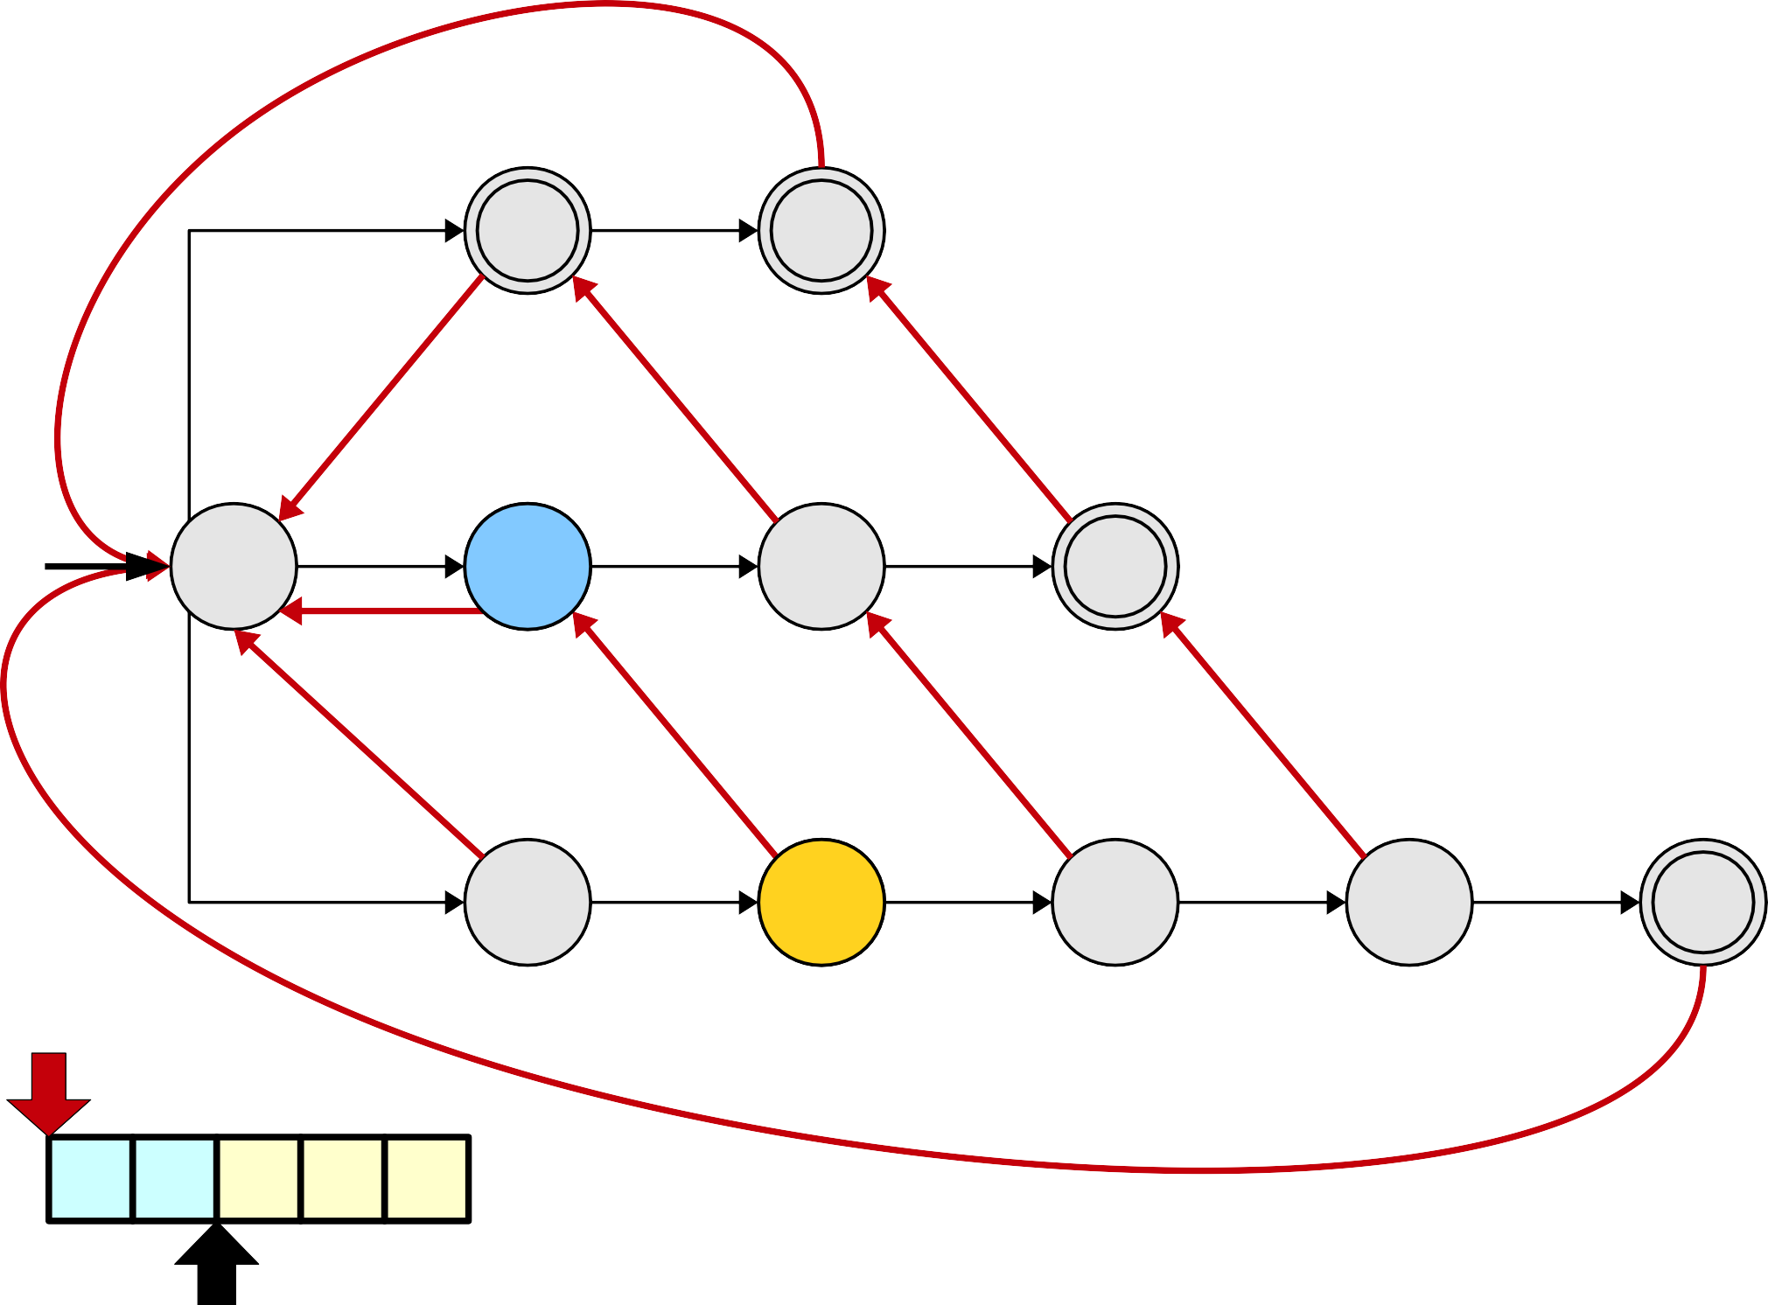
Pattern Strings
i
i | n
t | i | n
s | t | i | n | g
i
n
t
i
n
s
t
i
n
g
s
t
i
n
g

Slide 127
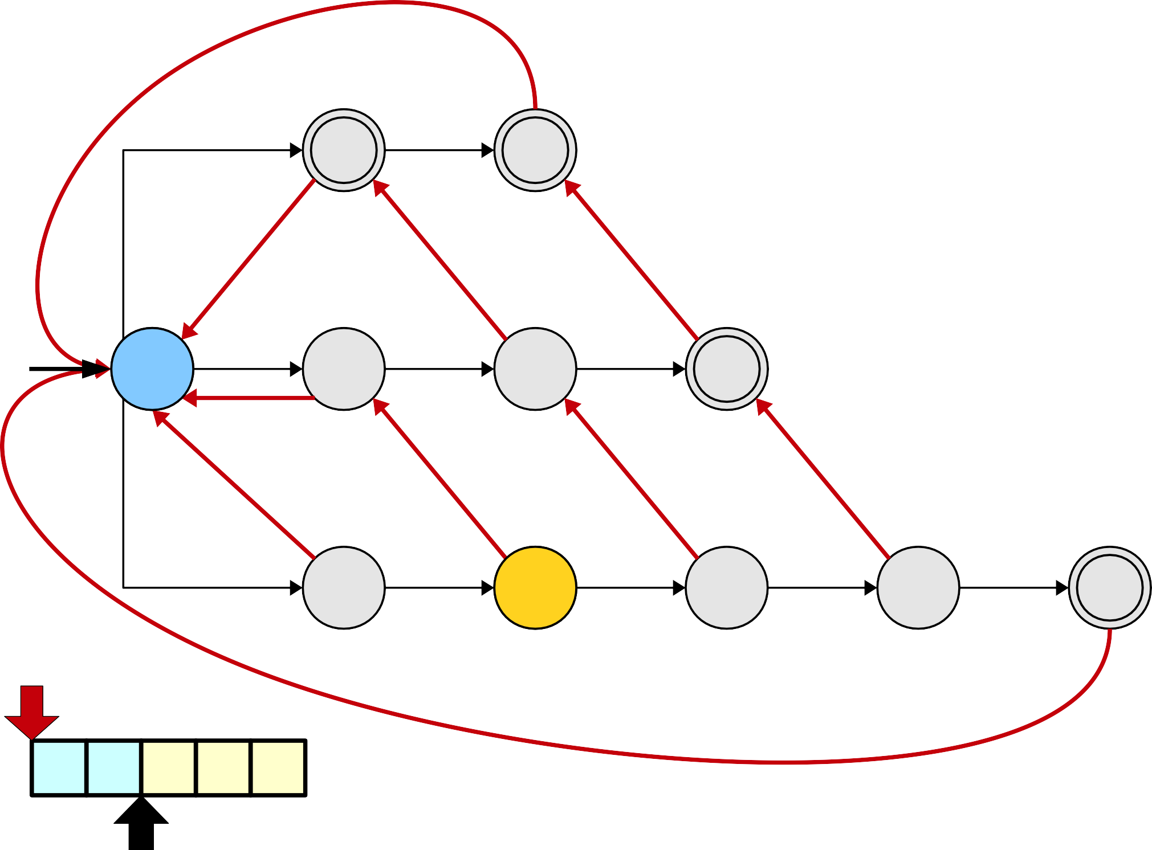
Pattern Strings
i
i | n
t | i | n
s | t | i | n | g
i
n
t
i
n
s
t
i
n
g
s
t
i
n
g

Slide 128
Pattern Strings
i
i | n
t | i | n
s | t | i | n | g
i
n
t
i
n
s
t
i
n
g
s
t
i
n
g

Slide 129
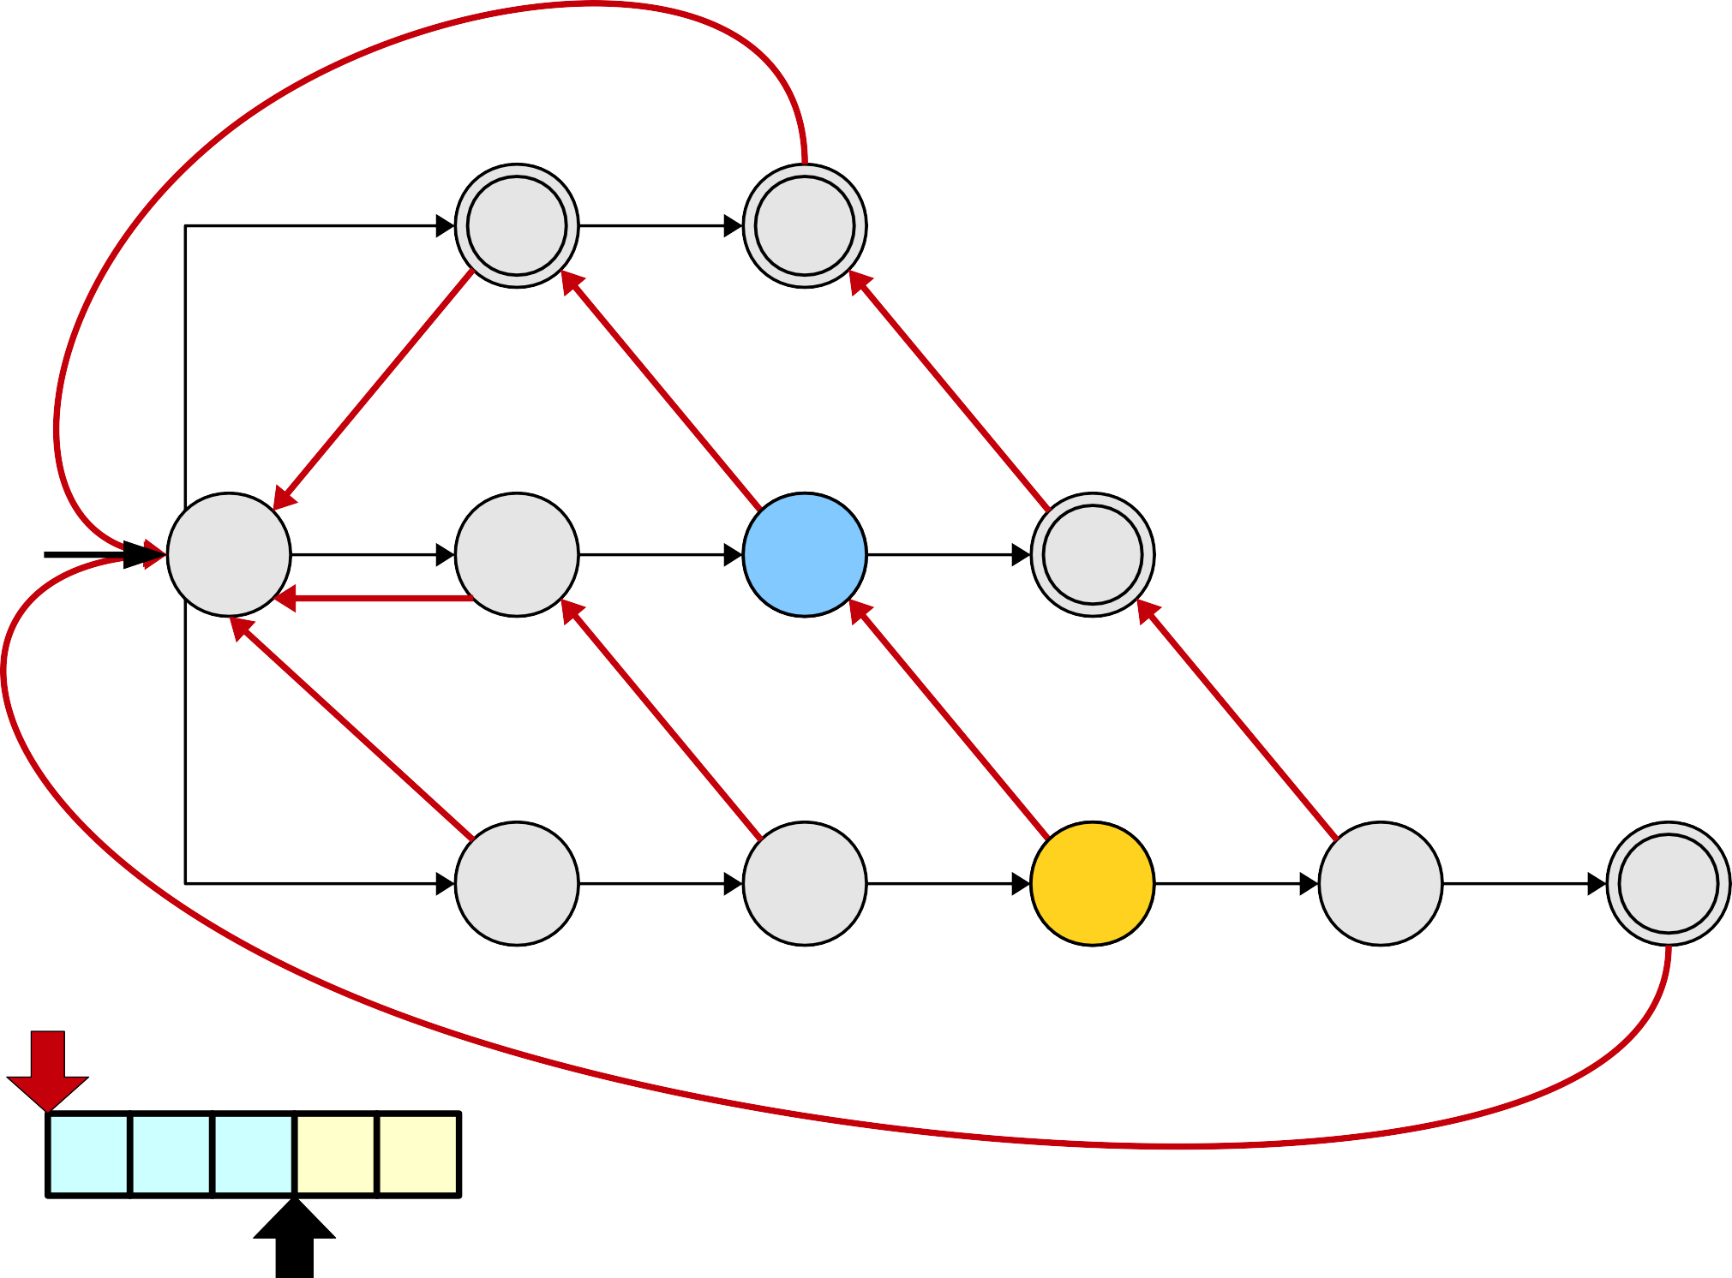
Pattern Strings
i
i | n
t | i | n
s | t | i | n | g
i
n
t
i
n
s
t
i
n
g
s
t
i
n
g

Slide 130
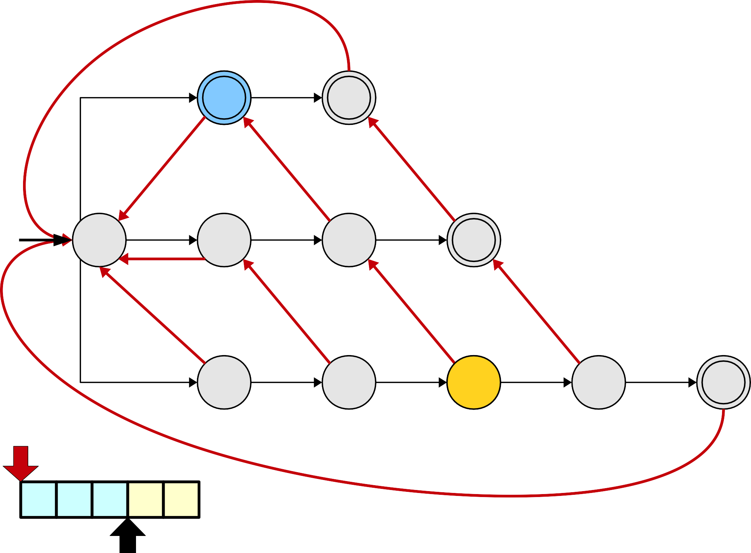
Pattern Strings
i
i | n
t | i | n
s | t | i | n | g
i
n
t
i
n
s
t
i
n
g
s
t
i
n
g

Slide 131
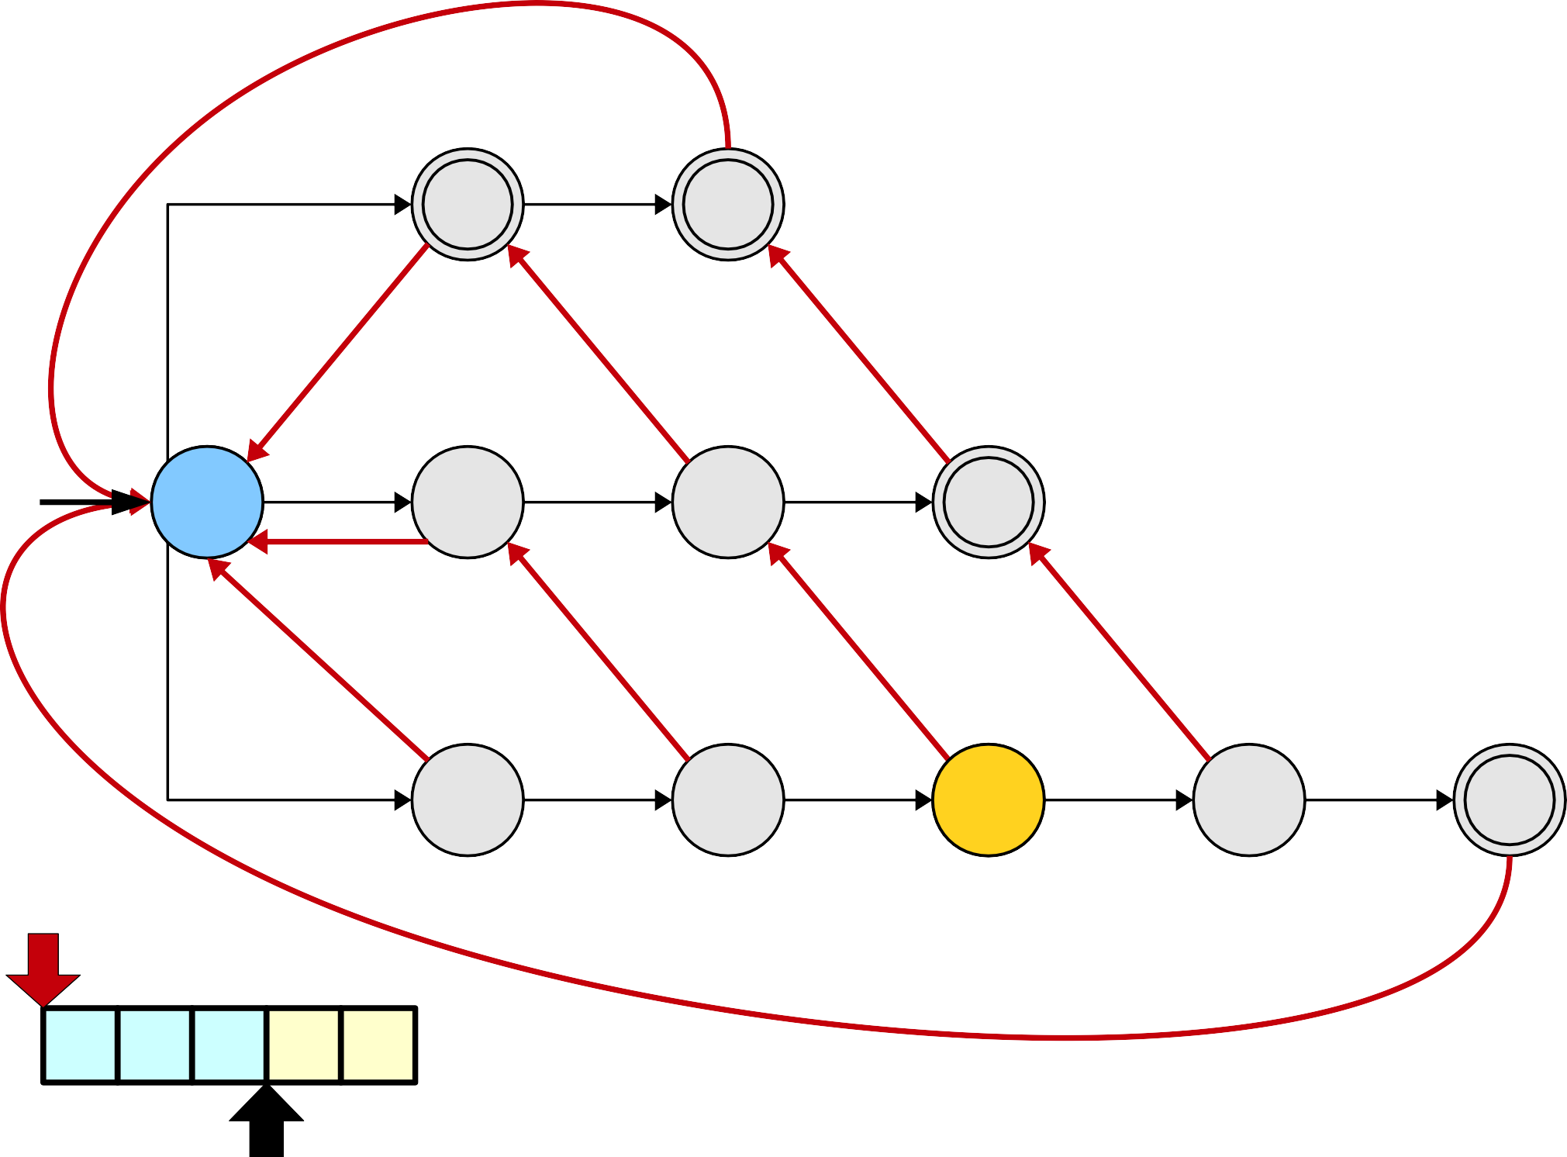
Pattern Strings
i
i | n
t | i | n
s | t | i | n | g
i
n
t
i
n
s
t
i
n
g
s
t
i
n
g

Slide 132
Pattern Strings
i
i | n
t | i | n
s | t | i | n | g
i
n
t
i
n
s
t
i
n
g
s
t
i
n
g

Slide 133
Pattern Strings
i
i | n
t | i | n
s | t | i | n | g
i
n
t
i
n
s
t
i
n
g
s
t
i
n
g

Slide 134
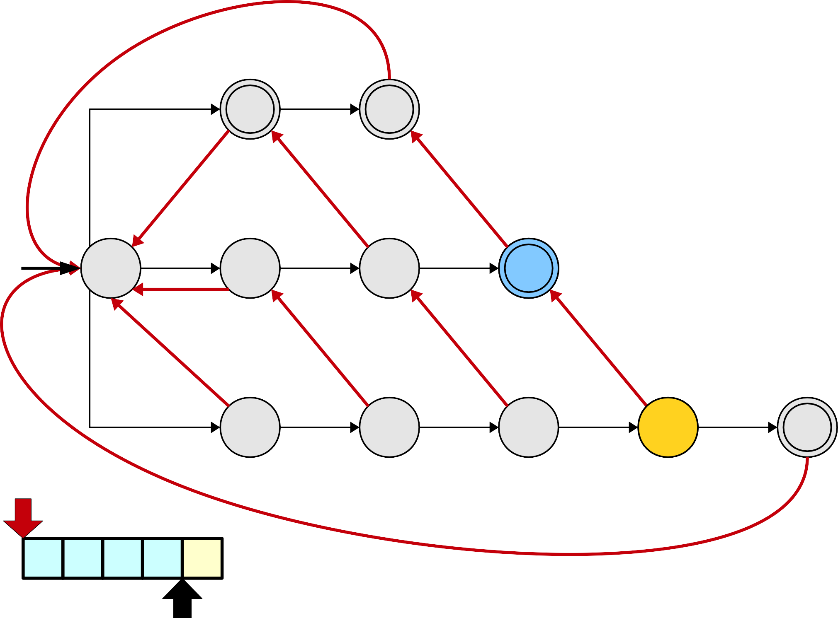
Pattern Strings
i
i | n
t | i | n
s | t | i | n | g
i
n
t
i
n
s
t
i
n
g
s
t
i
n
g

Slide 135
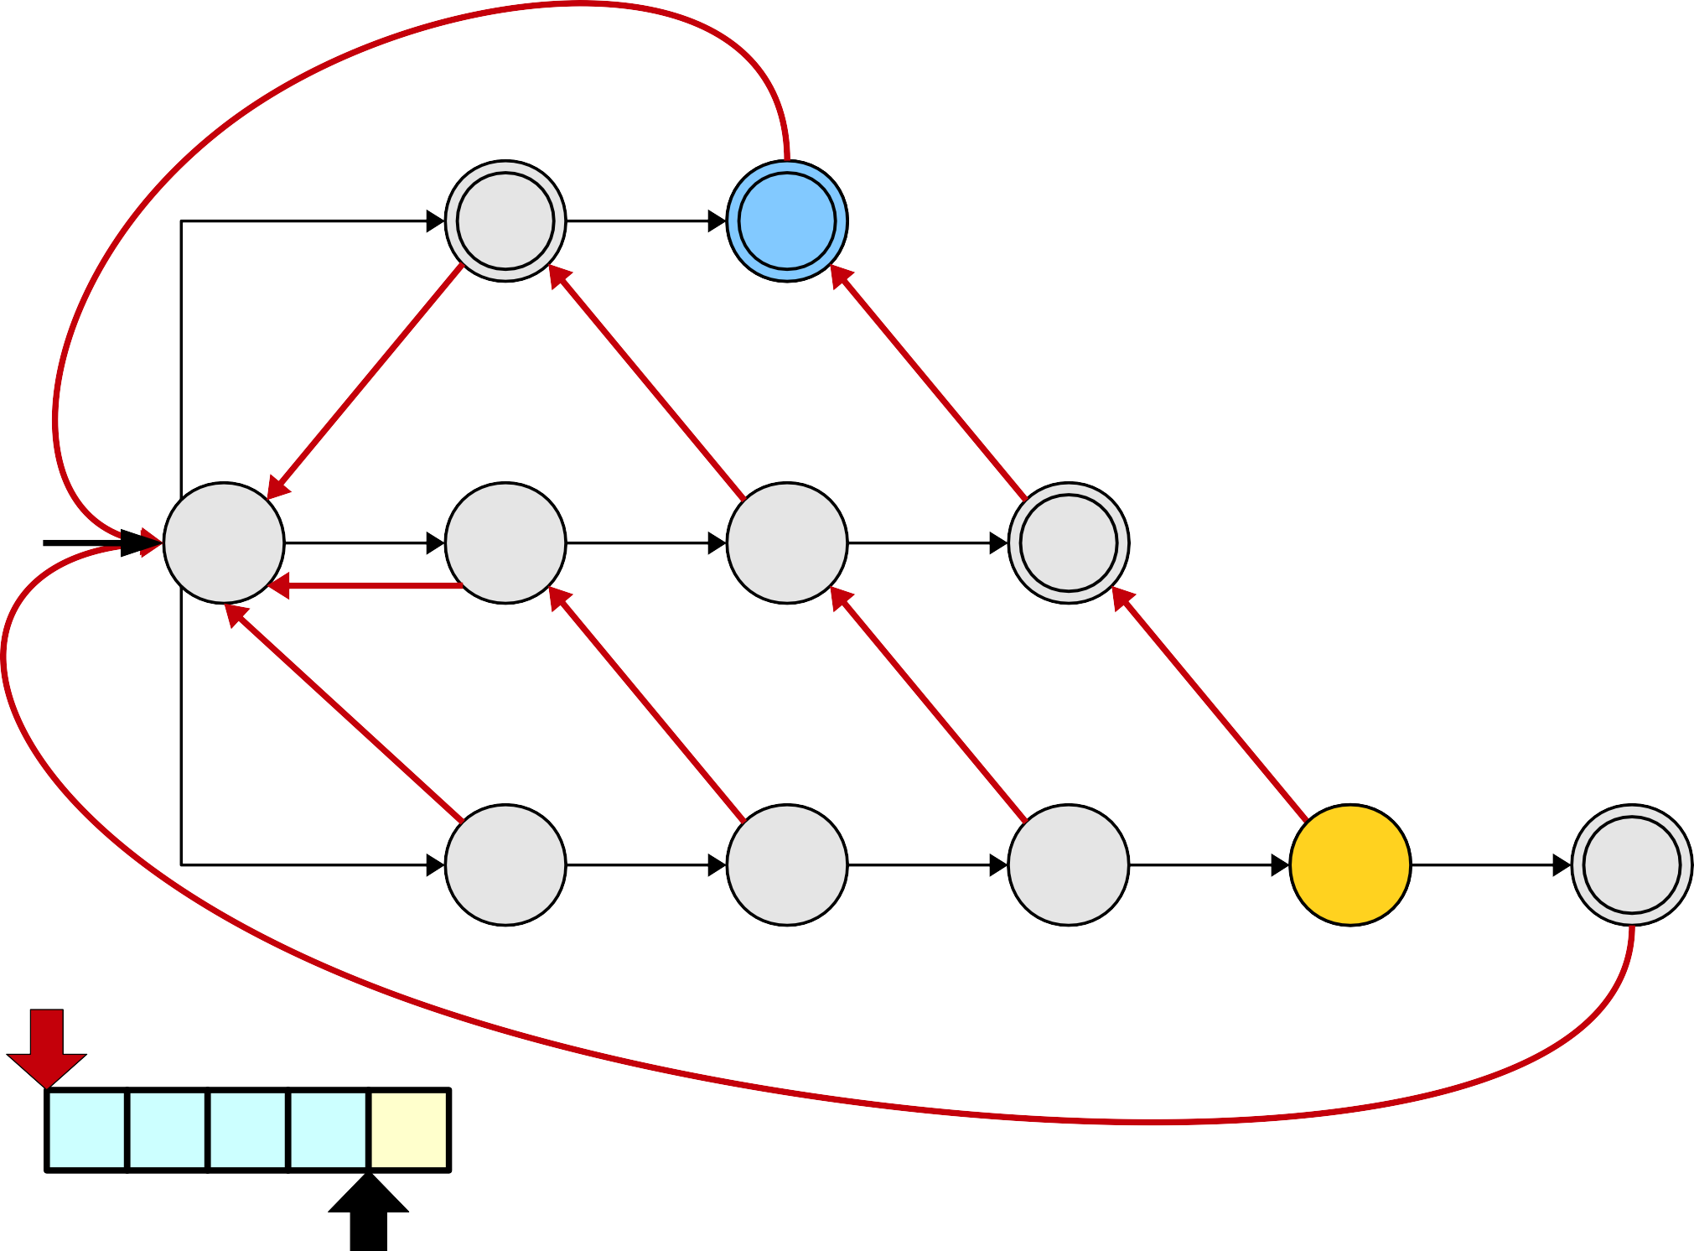
Pattern Strings
i
i | n
t | i | n
s | t | i | n | g
i
n
t
i
n
s
t
i
n
g
s
t
i
n
g

Slide 136
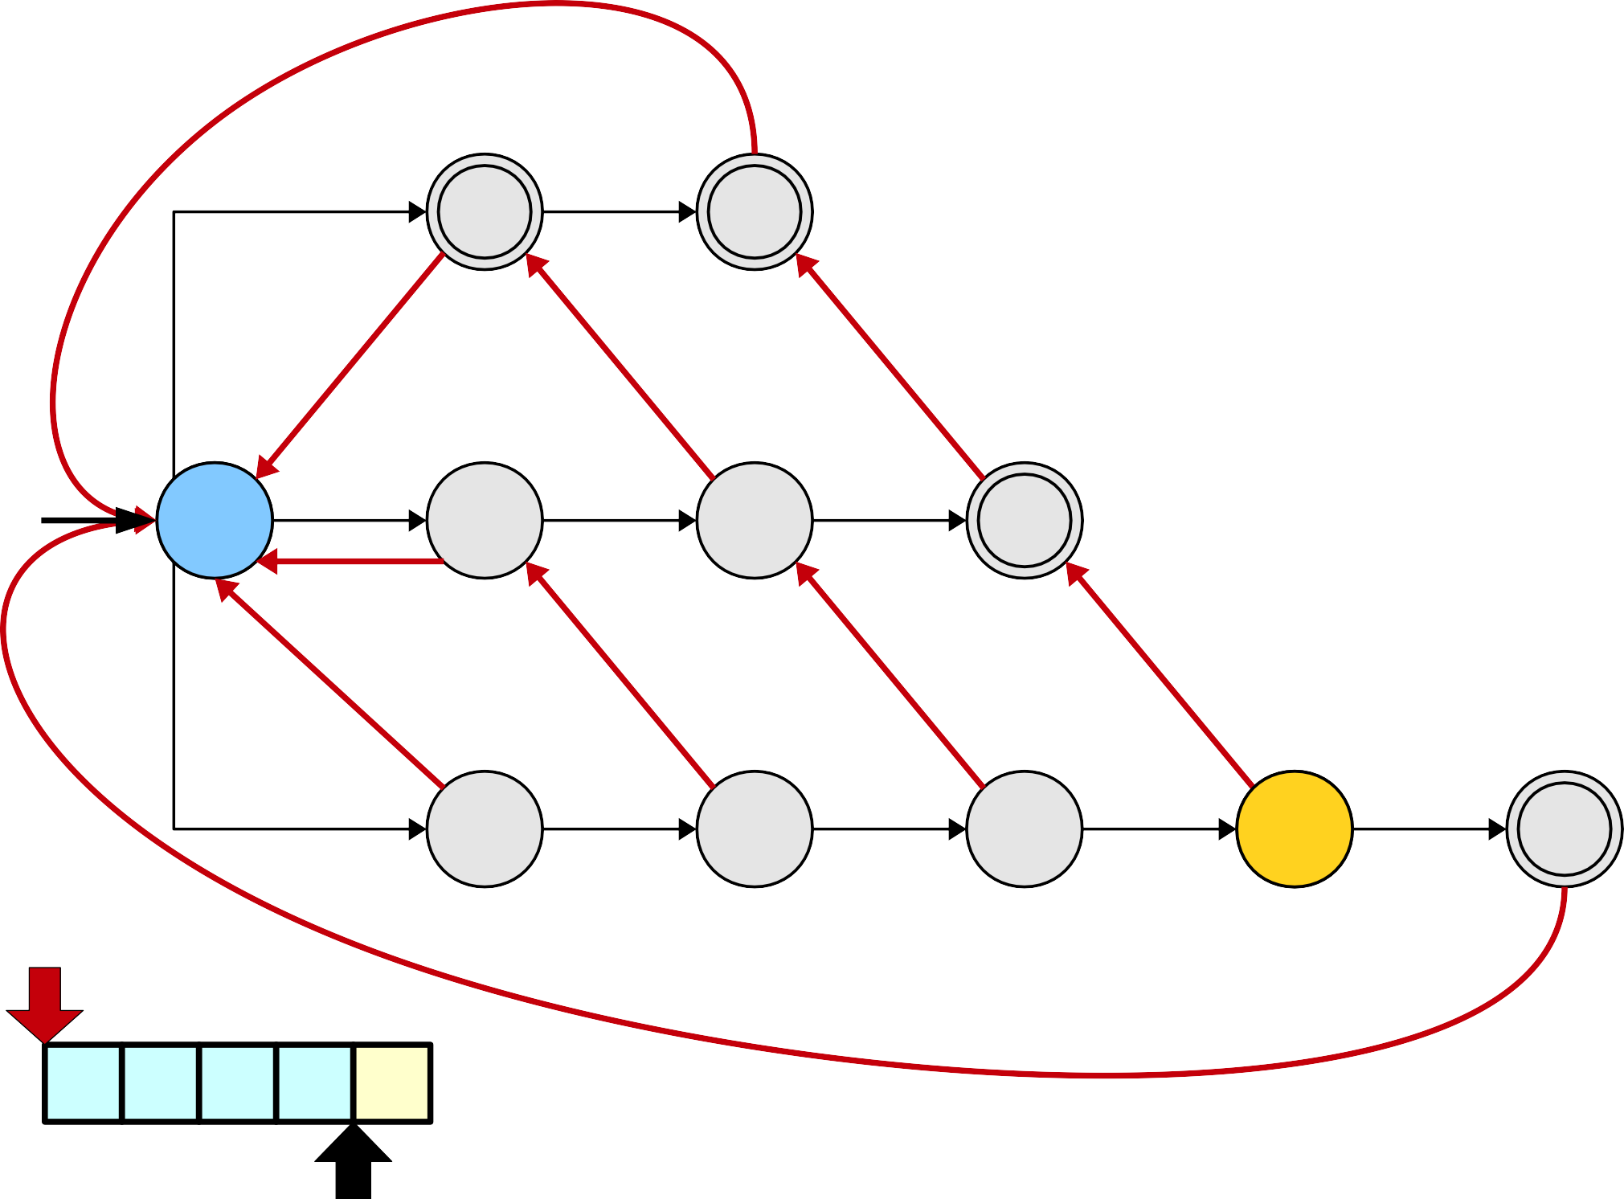
Pattern Strings
i
i | n
t | i | n
s | t | i | n | g
i
n
t
i
n
s
t
i
n
g
s
t
i
n
g

Slide 137
Pattern Strings
i
i | n
t | i | n
s | t | i | n | g
i
n
t
i
n
s
t
i
n
g
s
t
i
n
g

Slide 138

Pattern Strings
i
i | n
t | i | n
s | t | i | n | g
i
n
t
i
n
s
t
i
n
g
s
t
i
n
g

Slide 139
The Problem
The approach described previously will ensure that we don't miss any patterns, but it increases the complexity of the search.
Specifically, we do O(L_{max}) additional work at each character following suffix links backwards.
This brings our search cost back up to O(mL_{max}) again – and that's too slow.
Can we do better?
●
●
●
●

Slide 140

Pattern Strings
i
i | n
t | i | n
s | t | i | n | g
i
n
t
i
n
s
t
i
n
g

Slide 141

Pattern Strings
i
i | n
t | i | n
s | t | i | n | g
i
n
t
i
n
s
t
i
n
g

Slide 142

Pattern Strings
i
i | n
t | i | n
s | t | i | n | g
i
n
t
i
n
s
t
i
n
g

Slide 143
Pattern Strings
i
i | n
t | i | n
s | t | i | n | g
i
n
t
i
n
s
t
i
n
g
This blue arrow is called an output link. Whenever we visit this gold node, we'll output the string represented by the node at the end of the blue arrow.

Slide 144

Pattern Strings
i
i | n
t | i | n
s | t | i | n | g
i
n
t
i
n
s
t
i
n
g

Slide 145
Pattern Strings
i
i | n
t | i | n
s | t | i | n | g
i
n
t
i
n
s
t
i
n
g

Slide 146
Pattern Strings
i
i | n
t | i | n
s | t | i | n | g
i
n
t
i
n
s
t
i
n
g
By precomputing where we eventually need to end up, we can instantly read off any extra patterns to emit at this point. As you'll see, we can precompute these links really quickly!

Slide 147

Pattern Strings
i
i | n
t | i | n
s | t | i | n | g
i
n
t
i
n
s
t
i
n
g

Slide 148
Pattern Strings
i
i | n
t | i | n
s | t | i | n | g
i
n
t
i
n
s
t
i
n
g

Slide 149
Pattern Strings
i
i | n
t | i | n
s | t | i | n | g
i
n
t
i
n
s
t
i
n
g
Even nodes that themselves correspond to are patterns might need output links if other patterns also end at the corresponding string.

Slide 150

Pattern Strings
i
i | n
t | i | n
s | t | i | n | g
i
n
t
i
n
s
t
i
n
g

Slide 151
Pattern Strings
i
i | n
t | i | n
s | t | i | n | g
i
n
t
i
n
s
t
i
n
g

Slide 152
Pattern Strings
i
i | n
t | i | n
s | t | i | n | g
i
n
t
i
n
s
t
i
n
g
Notice that the blue edges here form a linked list. If we visit this node, we need to output everything in the chain, not just the “tin” node we're immediately pointing at.

Slide 153

Pattern Strings
i
i | n
t | i | n
s | t | i | n | g
i
n
t
i
n
s
t
i
n
g

Slide 154
Pattern Strings
i
i | n
t | i | n
s | t | i | n | g
i
n
t
i
n
s
t
i
n
g
s | t | i | n | g

Slide 155
Pattern Strings
i
i | n
t | i | n
s | t | i | n | g
i
n
t
i
n
s
t
i
n
g
s | t | i | n | g

Slide 156
Pattern Strings
i
i | n
t | i | n
s | t | i | n | g
i
n
t
i
n
s
t
i
n
g
s | t | i | n | g

Slide 157
Pattern Strings
i
i | n
t | i | n
s | t | i | n | g
i
n
t
i
n
s
t
i
n
g
s | t | i | n | g

Slide 158
Pattern Strings
i
i | n
t | i | n
s | t | i | n | g
i
n
t
i
n
s
t
i
n
g
s | t | i | n | g

Slide 159

Pattern Strings
i
i | n
t | i | n
s | t | i | n | g
i
n
t
i
n
s
t
i
n
g
s | t | i | n | g

Slide 160
Pattern Strings
i
i | n
t | i | n
s | t | i | n | g
i
n
t
i
n
s
t
i
n
g
s | t | i | n | g

Slide 161
Pattern Strings
i
i | n
t | i | n
s | t | i | n | g
i
n
t
i
n
s
t
i
n
g
s | t | i | n | g

Slide 162
Pattern Strings
i
i | n
t | i | n
s | t | i | n | g
i
n
t
i
n
s
t
i
n
g
s | t | i | n | g

Slide 163

Pattern Strings
i
i | n
t | i | n
s | t | i | n | g
i
n
t
i
n
s
t
i
n
g
s | t | i | n | g

Slide 164
Pattern Strings
i
i | n
t | i | n
s | t | i | n | g
i
n
t
i
n
s
t
i
n
g
s | t | i | n | g

Slide 165

Pattern Strings
i
i | n
t | i | n
s | t | i | n | g
i
n
t
i
n
s
t
i
n
g
s | t | i | n | g

Slide 166
Pattern Strings
i
i | n
t | i | n
s | t | i | n | g
i
n
t
i
n
s
t
i
n
g
s | t | i | n | g

Slide 167
Pattern Strings
i
i | n
t | i | n
s | t | i | n | g
i
n
t
i
n
s
t
i
n
g
s | t | i | n | g

Slide 168

Pattern Strings
i
i | n
t | i | n
s | t | i | n | g
i
n
t
i
n
s
t
i
n
g
s | t | i | n | g

Slide 169
Pattern Strings
i
i | n
t | i | n
s | t | i | n | g
i
n
t
i
n
s
t
i
n
g
s
t
i
n
g

Slide 170
The Final Matching Algorithm
Start at the root node in the trie. For each character c in the string:
●
●
While there is no edge labeled c:
If you're at the root, break out of this loop.
Otherwise, follow a suffix link.
If there is an edge labeled c, follow it.
If the current node corresponds to a pattern, output that pattern.
Output all words in the chain of output links originating at this node.
●
●
●
●

Slide 171
The Runtime Impact

Slide 172

a
a
a
a
Pattern Strings
a
a | a
a | a | a
a | a | a | a

Slide 173
a
a
a
a
Pattern Strings
a
a | a
a | a | a
a | a | a | a
a | a | a | a | a | a | a | a

Slide 174

a
a
a
a
Pattern Strings
a
a | a
a | a | a
a | a | a | a
a | a | a | a | a | a | a | a

Slide 175

a
a
a
a
Pattern Strings
a
a | a
a | a | a
a | a | a | a
a | a | a | a | a | a | a | a

Slide 176
a
a
a
a
Pattern Strings
a
a | a
a | a | a
a | a | a | a
a | a | a | a | a | a | a | a

Slide 177

a
a
a
a
Pattern Strings
a
a | a
a | a | a
a | a | a | a
a | a | a | a | a | a | a | a

Slide 178
a
a
a
a
Pattern Strings
a
a | a
a | a | a
a | a | a | a
a | a | a | a | a | a | a | a

Slide 179

a
a
a
a
Pattern Strings
a
a | a
a | a | a
a | a | a | a
a | a | a | a | a | a | a | a

Slide 180
a
a
a
a
Pattern Strings
a
a | a
a | a | a
a | a | a | a
a | a | a | a | a | a | a | a

Slide 181

a
a
a
a
Pattern Strings
a
a | a
a | a | a
a | a | a | a
a | a | a | a | a | a | a | a

Slide 182
a
a
a
a
Pattern Strings
a
a | a
a | a | a
a | a | a | a
a | a | a | a | a | a | a | a

Slide 183
a
a
a
a
Pattern Strings
a
a | a
a | a | a
a | a | a | a
a | a | a | a | a | a | a | a

Slide 184
a
a
a
a
Pattern Strings
a
a | a
a | a | a
a | a | a | a
a | a | a | a | a | a | a | a

Slide 185
a
a
a
a
Pattern Strings
a
a | a
a | a | a
a | a | a | a
a | a | a | a | a | a | a | a

Slide 186
a
a
a
a
Pattern Strings
a
a | a
a | a | a
a | a | a | a
a | a | a | a | a | a | a | a

Slide 187
a
a
a
a
Pattern Strings
a
a | a
a | a | a
a | a | a | a
a | a | a | a | a | a | a | a

Slide 188
a
a
a
a
Pattern Strings
a
a | a
a | a | a
a | a | a | a
a | a | a | a | a | a | a | a

Slide 189
a
a
a
a
Pattern Strings
a
a | a
a | a | a
a | a | a | a
a | a | a | a | a | a | a | a

Slide 190
a
a
a
a
Pattern Strings
a
a | a
a | a | a
a | a | a | a
a | a | a | a | a | a | a | a

Slide 191
a
a
a
a
Pattern Strings
a
a | a
a | a | a
a | a | a | a
a | a | a | a | a | a | a | a

Slide 192
a
a
a
a
Pattern Strings
a
a | a
a | a | a
a | a | a | a
a | a | a | a | a | a | a | a

Slide 193
a
a
a
a
Pattern Strings
a
a | a
a | a | a
a | a | a | a
a | a | a | a | a | a | a | a

Slide 194
a
a
a
a
Pattern Strings
a
a | a
a | a | a
a | a | a | a
a | a | a | a | a | a | a | a

Slide 195
a
a
a
a
Pattern Strings
a
a | a
a | a | a
a | a | a | a
a | a | a | a | a | a | a | a

Slide 196
a
a
a
a
Pattern Strings
a
a | a
a | a | a
a | a | a | a
a | a | a | a | a | a | a | a

Slide 197
a
a
a
a
Pattern Strings
a
a | a
a | a | a
a | a | a | a
a | a | a | a | a | a | a | a

Slide 198
a
a
a
a
Pattern Strings
a
a | a
a | a | a
a | a | a | a
a | a | a | a | a | a | a | a

Slide 199
a
a
a
a
Pattern Strings
a
a | a
a | a | a
a | a | a | a
a | a | a | a | a | a | a | a

Slide 200
a
a
a
a
Pattern Strings
a
a | a
a | a | a
a | a | a | a
a | a | a | a | a | a | a | a

Slide 201
a
a
a
a
Pattern Strings
a
a | a
a | a | a
a | a | a | a
a | a | a | a | a | a | a | a

Slide 202
a
a
a
a
Pattern Strings
a
a | a
a | a | a
a | a | a | a
a | a | a | a | a | a | a | a

Slide 203
The Runtime
In the worst case, we may have to spend a huge amount of time listing off all the matches in the string.
This isn't the fault of the algorithm – any algorithm that matches strings this way would have to spend the time reporting matches.
To account for this, let z denote the number of matches reported by our algorithm.
The runtime of the match phase is then Θ(m + z), with the m term coming from the string scanning and the z term coming from the matches.
●
●
●
●
●
You sometimes hear algorithms whose runtime depends on how much output is generated referred to as output-sensitive algorithms.

